Slide 1
PROCEDURE FOR DEACTIVATION OF REVERSER ENGINE CF-6
AMM 78-31-00-040-801-A
DEACTIVATION OF THE REVERSER CF-6

Slide 2
PROCEDURE FOR DEACTIVATION OF REVERSER ENGINE CF-6
AMM 78-31-00-040-801-A
OPEN SAFETY AND TAG THE CIRCUIT BREAKER:
FOR FIN 4030EM1(DEMOUNTABLE POWER PLANT, ENG1)
721VU | TRPV ENG 1 | 38KS1 | S09
721VU | TRDV ENG 1 | 37KS1 | S08
722VU | FADEC B ENG 1 | 13KS1 | D44
742VU | FADEC A ENG 1 | 12KS1 | Q73
FOR FIN 4030EM2(DEMOUNTABLE POWER PLANT, ENG2)
722VU | FADEC B ENG 2 | 13KS2 | K49
722VU | TRDV ENG 2 | 37KS2 | T36
722VU | TRPV ENG 2 | 38KS2 | U36
742VU | FADEC A ENG 2 | 12KS2 | Q74

Slide 3
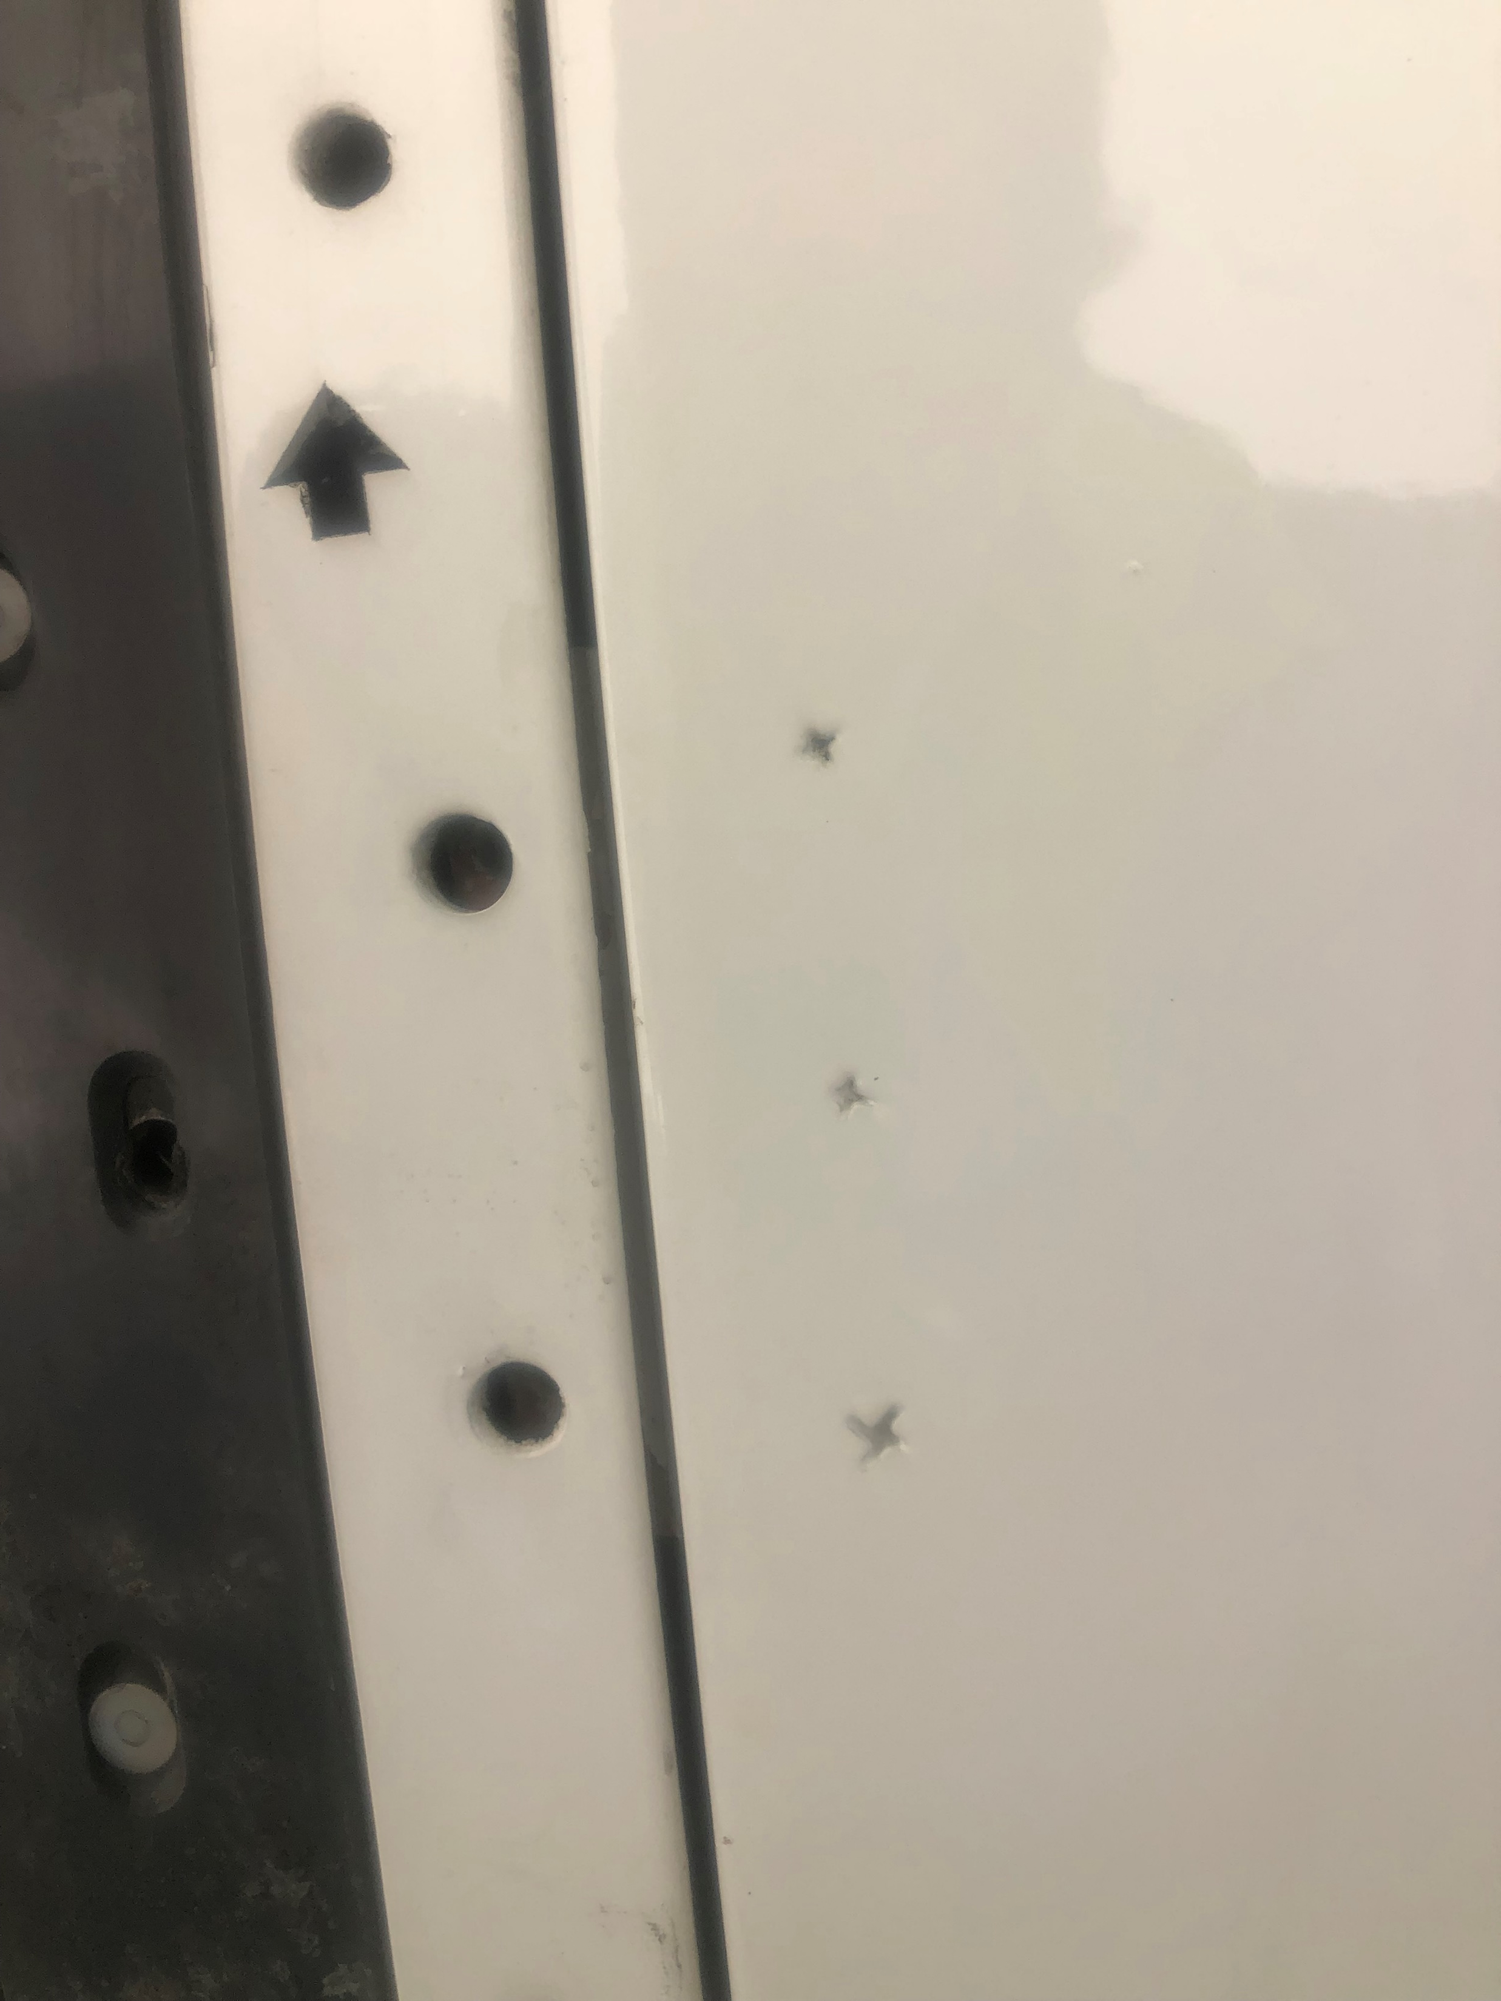
PROCEDURE FOR DEACTIVATION OF REVERSER ENGINE CF-6
AMM 78-31-00-040-801-A
*MAKE SURE THE TRANSLATING COWL IS IN THE FULLY STOWED POSITIÓN.
IF THE REVERSES ARE NOT CLOSED OR THE HOLES ARE NOT ALIGNED WITH THE FIXING NUTS.
GO TO “MANUAL CLOSURE OF THE REVERSES IN THIS PRESENTATION”

Slide 4
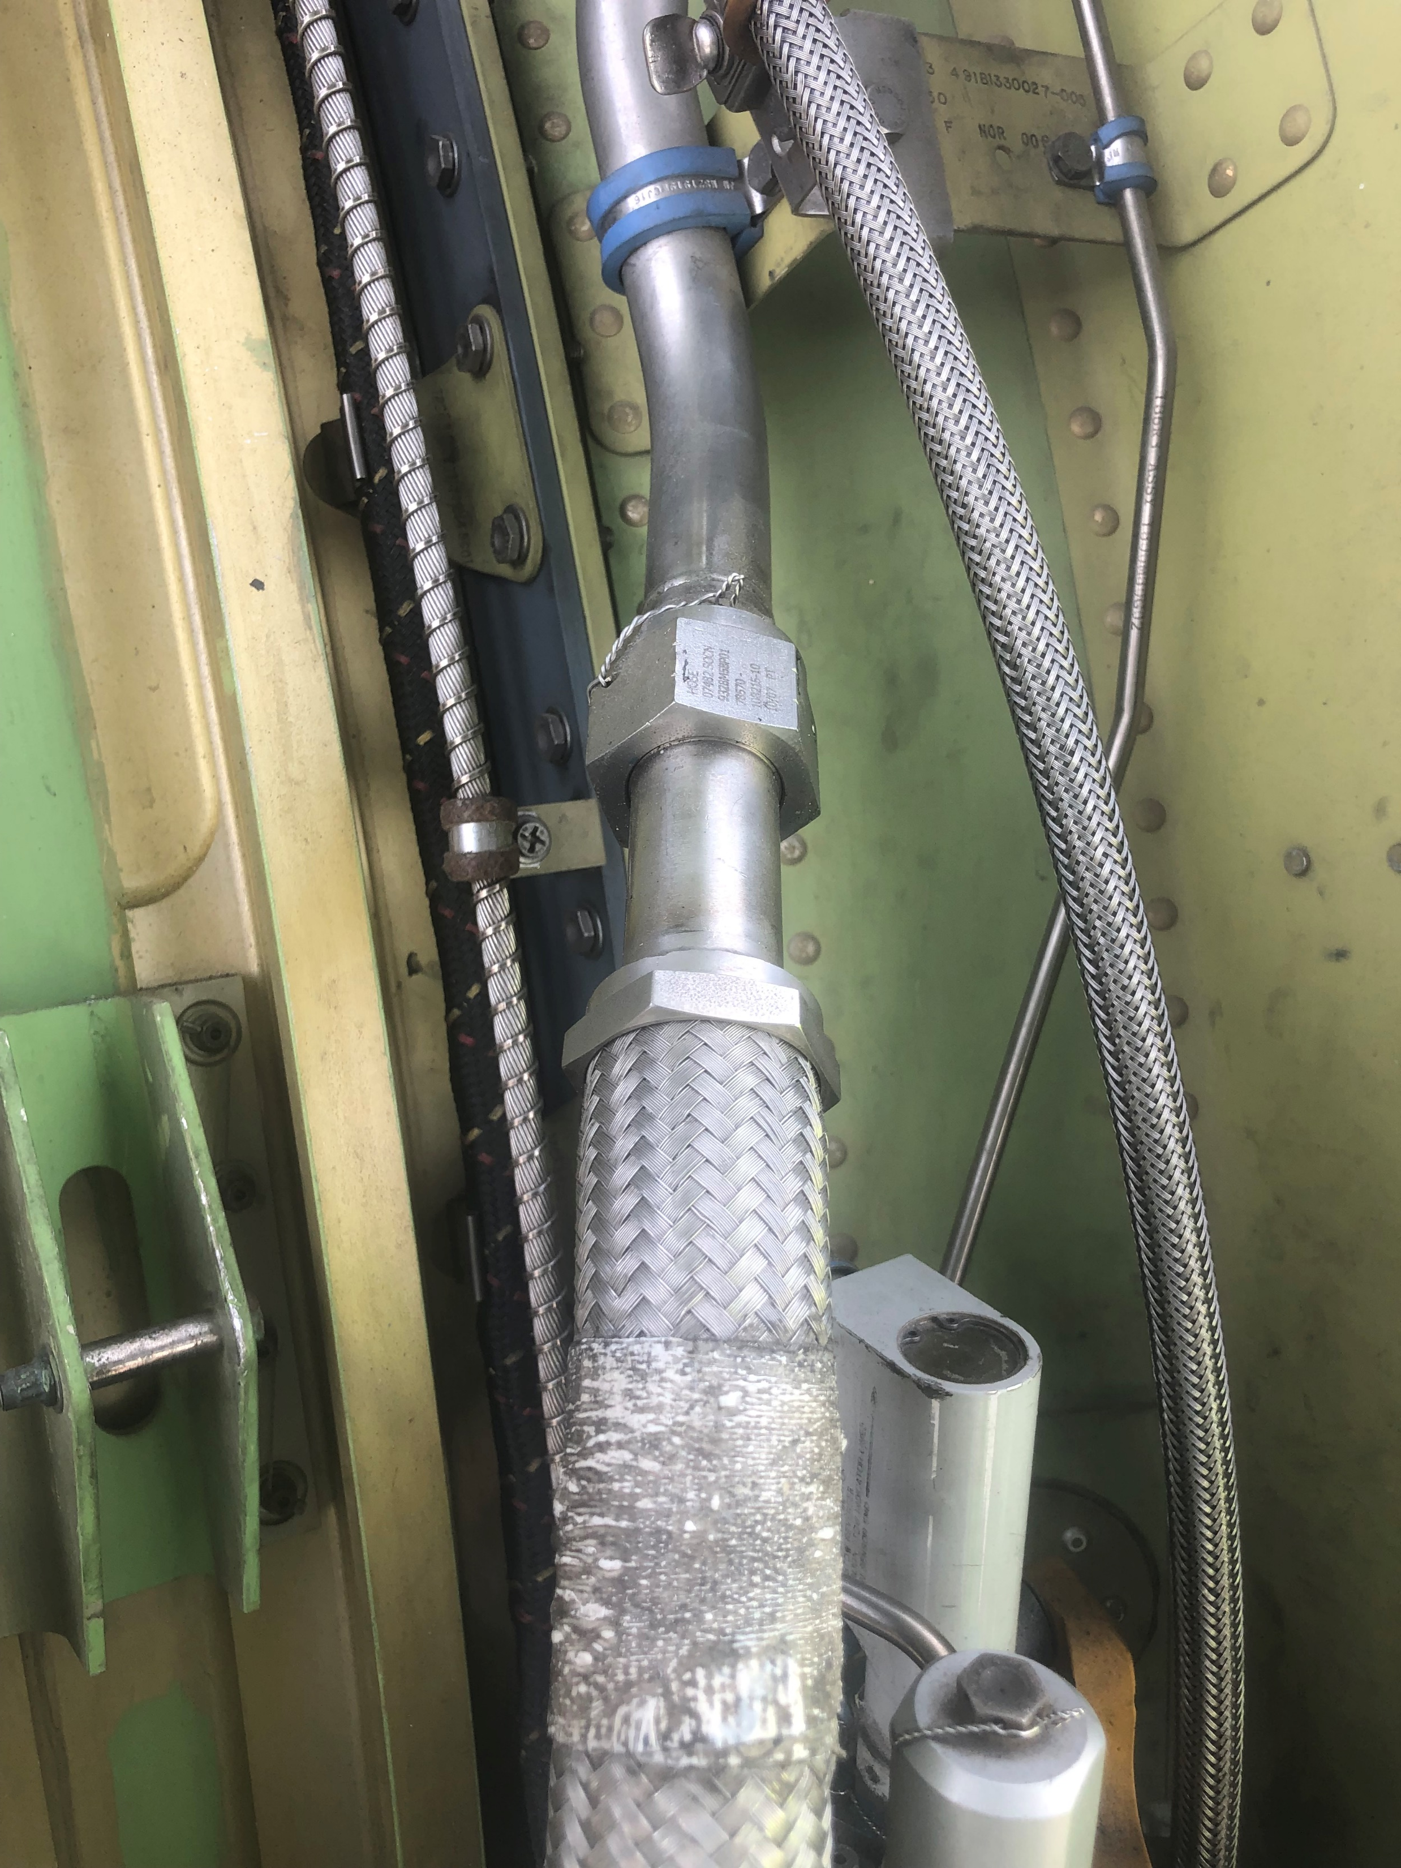
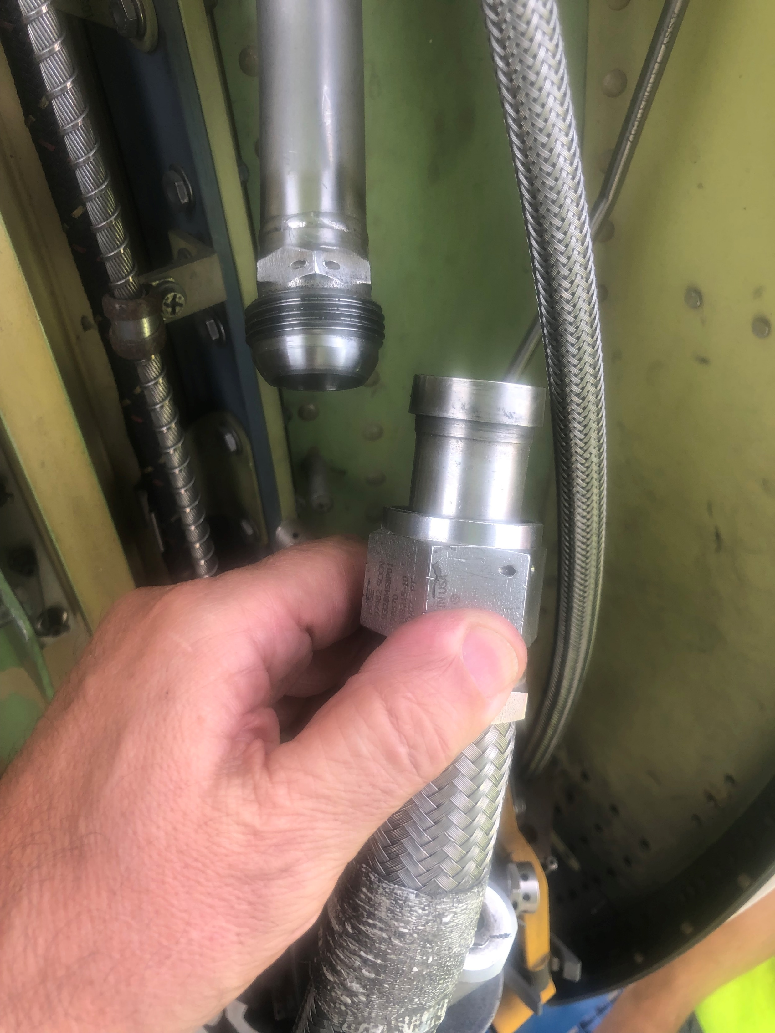
PROCEDURE FOR DEACTIVATION OF REVERSER ENGINE CF-6
AMM 78-31-00-040-801-A
*DISCONNECT THE FLEXIBLE PNEUMATIC TUBE FROM THE RIGID PNEUMATIC TUBE
*IN REVERSE LH
AND
*IN REVERSE RH

Slide 5
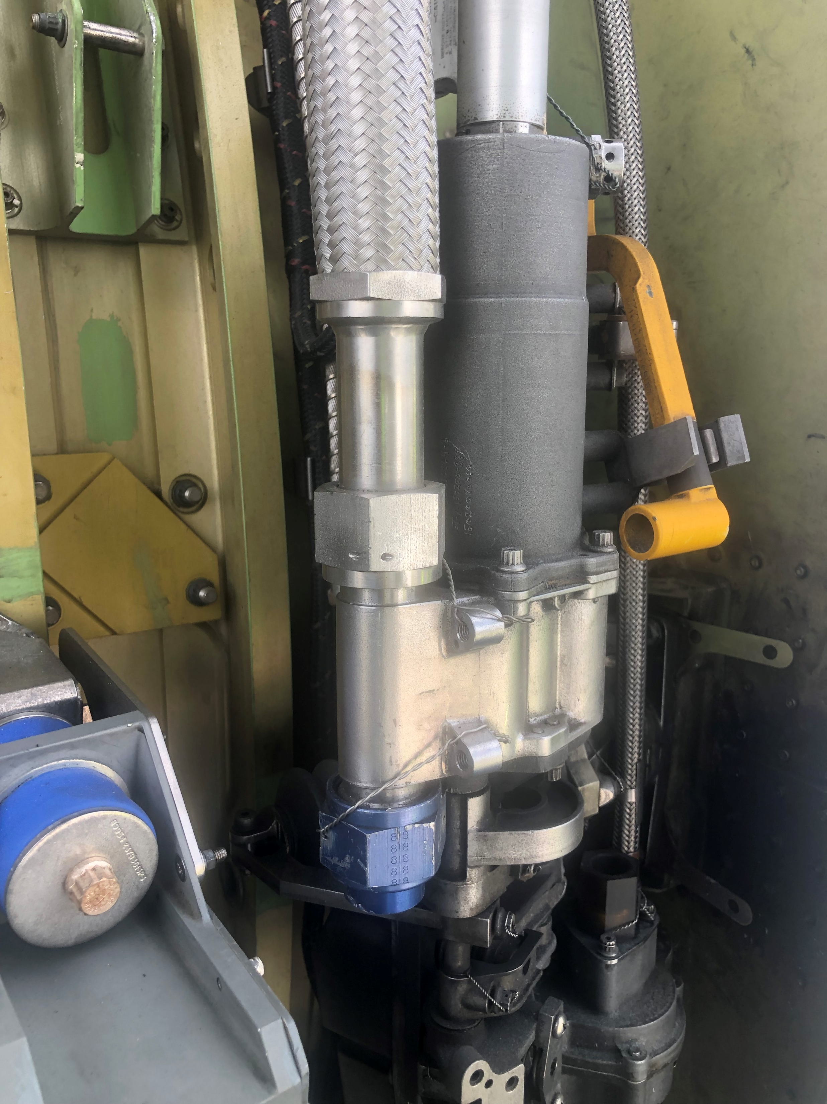
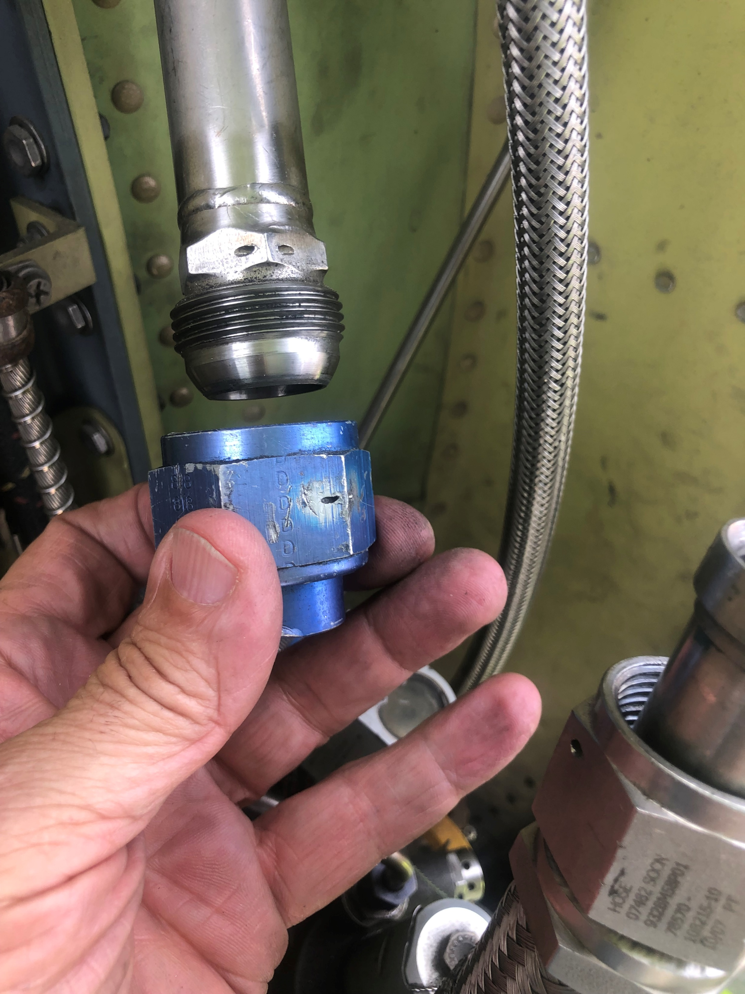
PROCEDURE FOR DEACTIVATION OF REVERSER ENGINE CF-6
AMM 78-31-00-040-801-A
*REMOVE THE BLUE ANODIZED CAP FROM THE UNUSED AIR SUPPLY PORT ON THE LOWER END OF THE CENTER DRIVE UNIT AND
*INSTALL THE BLUE ANODIZES CAP ON THE RIGID PNEUMATIC TUBE.
TORQUE THE BLUE ANODIZED CAP BETWEEN 820 AND 860 lbf.in
*IN REVERSE LH
AND
*IN REVERSE RH

Slide 6
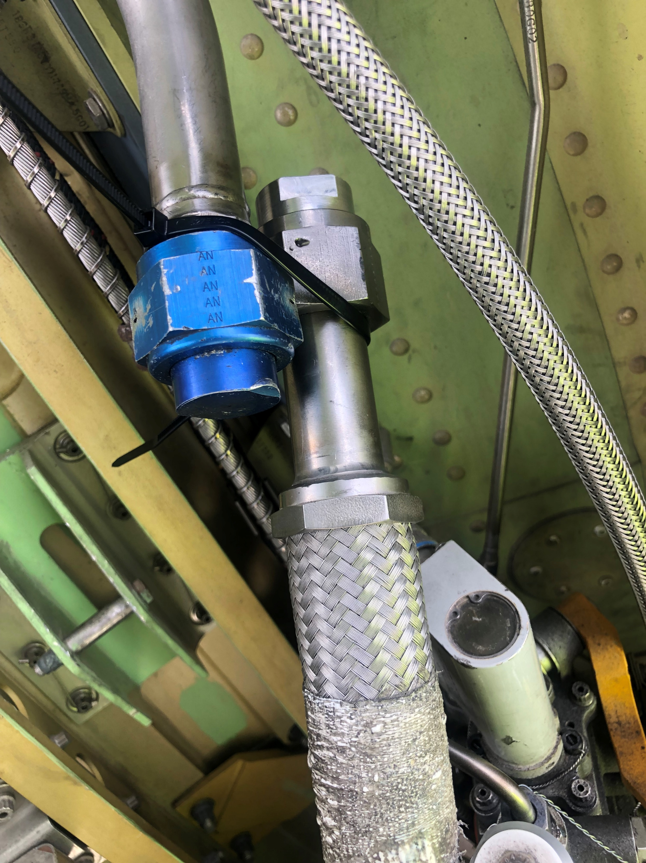
PROCEDURE FOR DEACTIVATION OF REVERSER ENGINE CF-6
AMM 78-31-00-040-801-A
*ATTACH THE FLEXIBLE PNEUMATIC TUBE TO THE AFT SIDE OF THE RIGID TUBE WITH LOCALLY OBTAINED TIE WRAP
*IN REVERSE LH
AND
*IN REVERSE RH

Slide 7
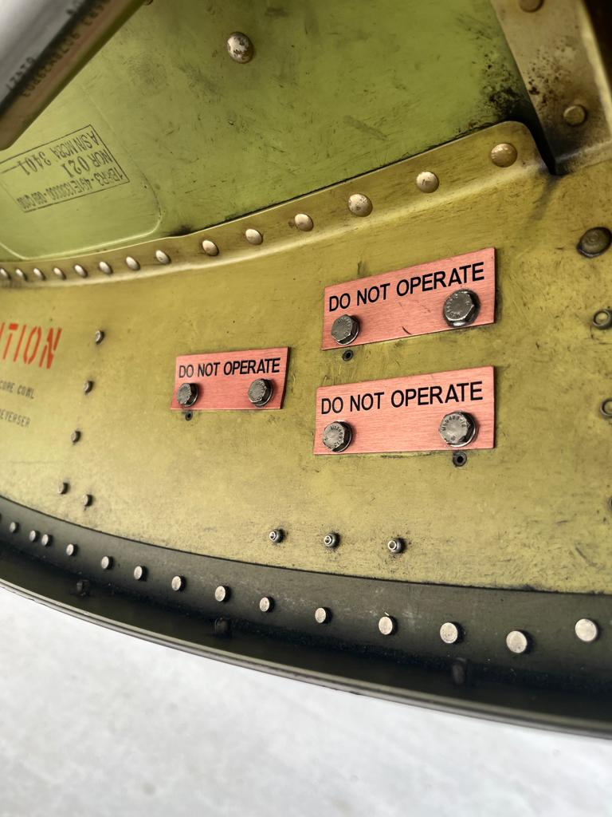
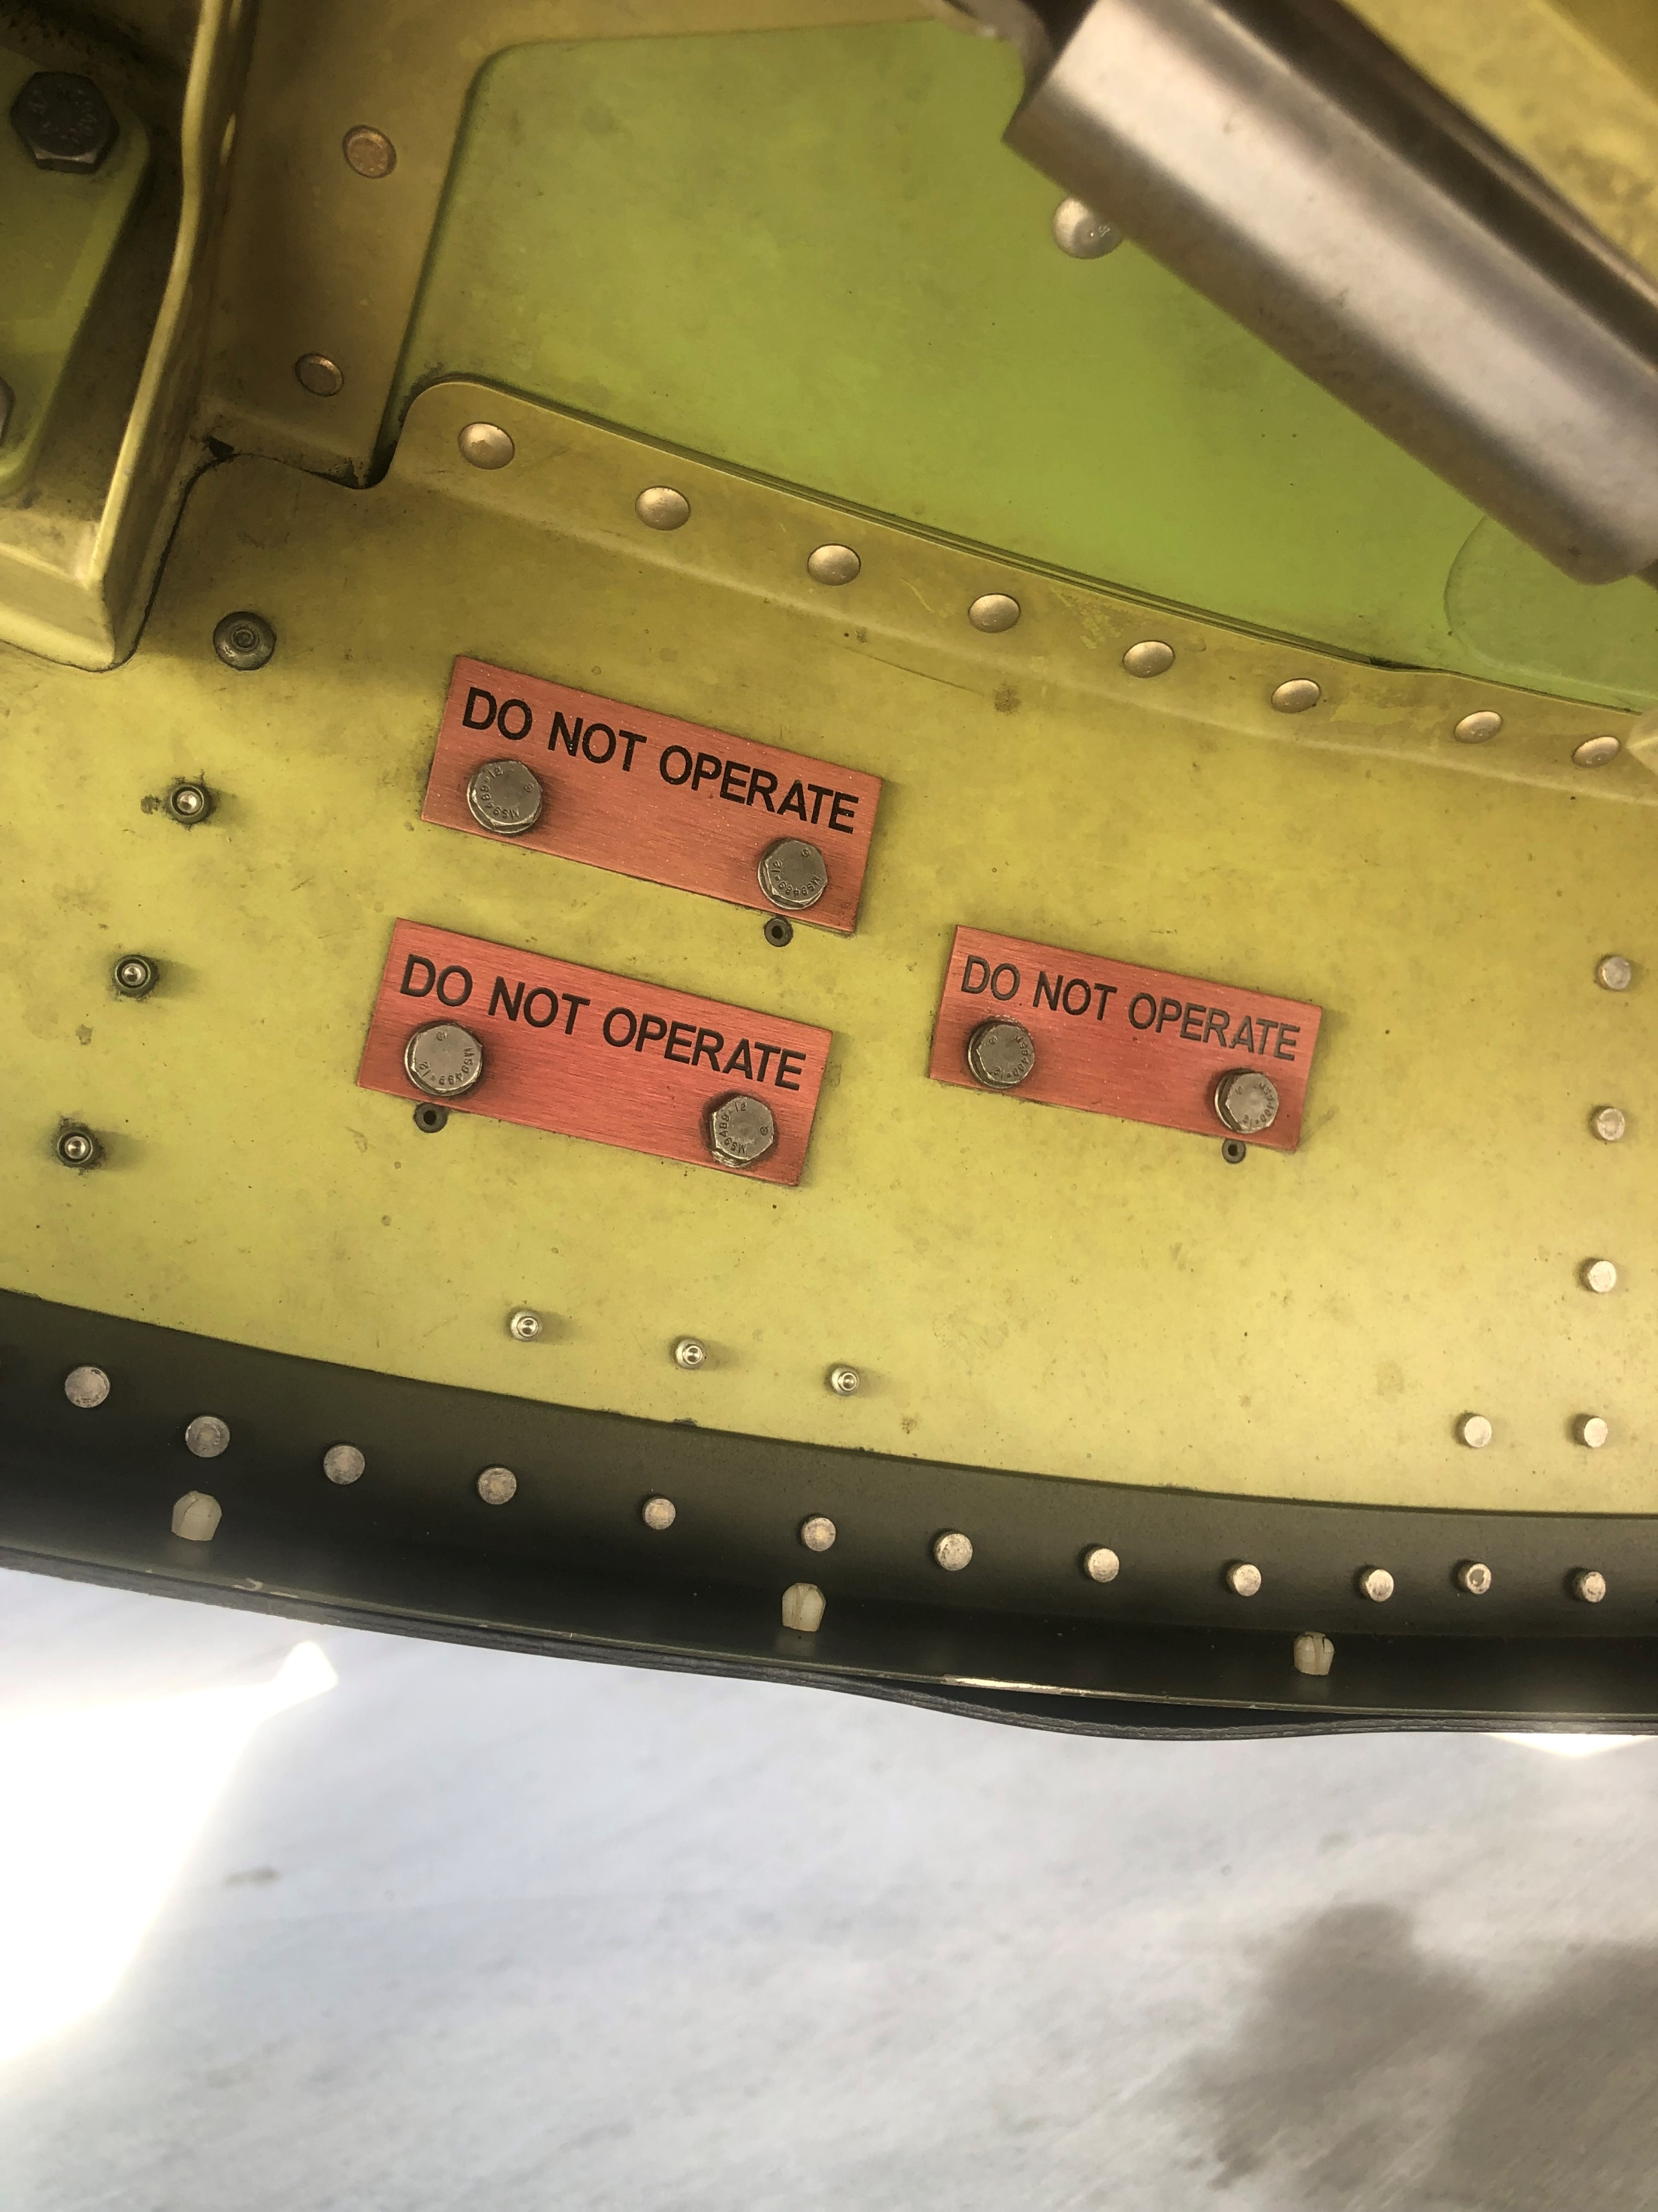
PROCEDURE FOR DEACTIVATION OF REVERSER ENGINE CF-6
AMM 78-31-00-040-801-A
*REMOVE THE THREE RED LOCKOUT PLATE LABELED “DO NOT OPERATE” FROM THE FIXED STRUCTURE OF EACH THRUST REVERSER HALF WILL BE DEACTIVATED.
*THE LOCKOUT PLATES ARE ATTACHED TO THE FIXED STRUTURE AT THE 5 AND 7 O`CLOCK POSITIONS

Slide 8

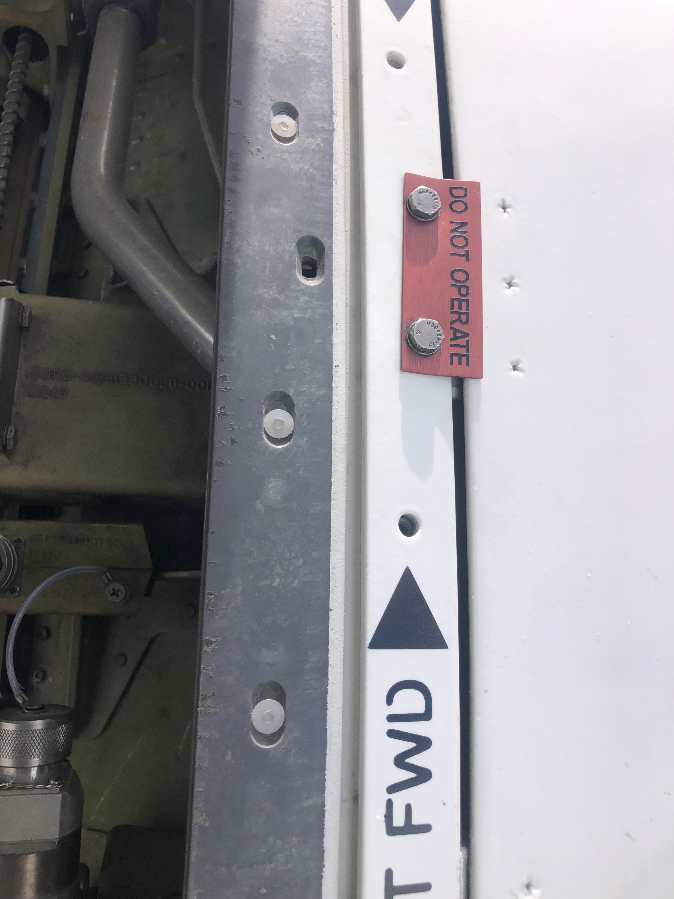
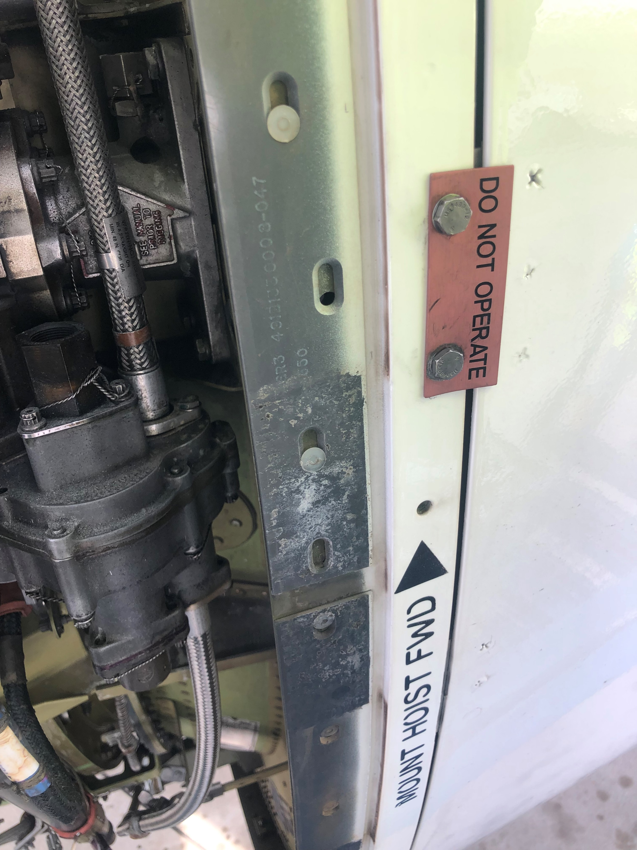
PROCEDURE FOR DEACTIVATION OF REVERSER ENGINE CF-6
AMM 78-31-00-040-801-A
*INSTALL THE THREE RED LOCKOUT PLATES, LABELED “DO NOT OPERATE” AT THE LOCK POINTS ON EACH TRANSLATING COWL LH AND RH
IF THE REVERSES ARE NOT CLOSED OR THE HOLES ARE NOT ALIGNED WITH THE FIXING NUTS.
GO TO “MANUAL CLOSURE OF THE REVERSES IN THIS PRESENTATION”
*INSTALL TWO BOLTS THROUGH EACH RED LOCKOUT PLATE, TRANSLATING COWL, AND FIXED STRUTURE AND INTO THE NUTPLATES. TORQUE THE BOLTS TO BETWEEN 33 AND 37 lbf.in.

Slide 9
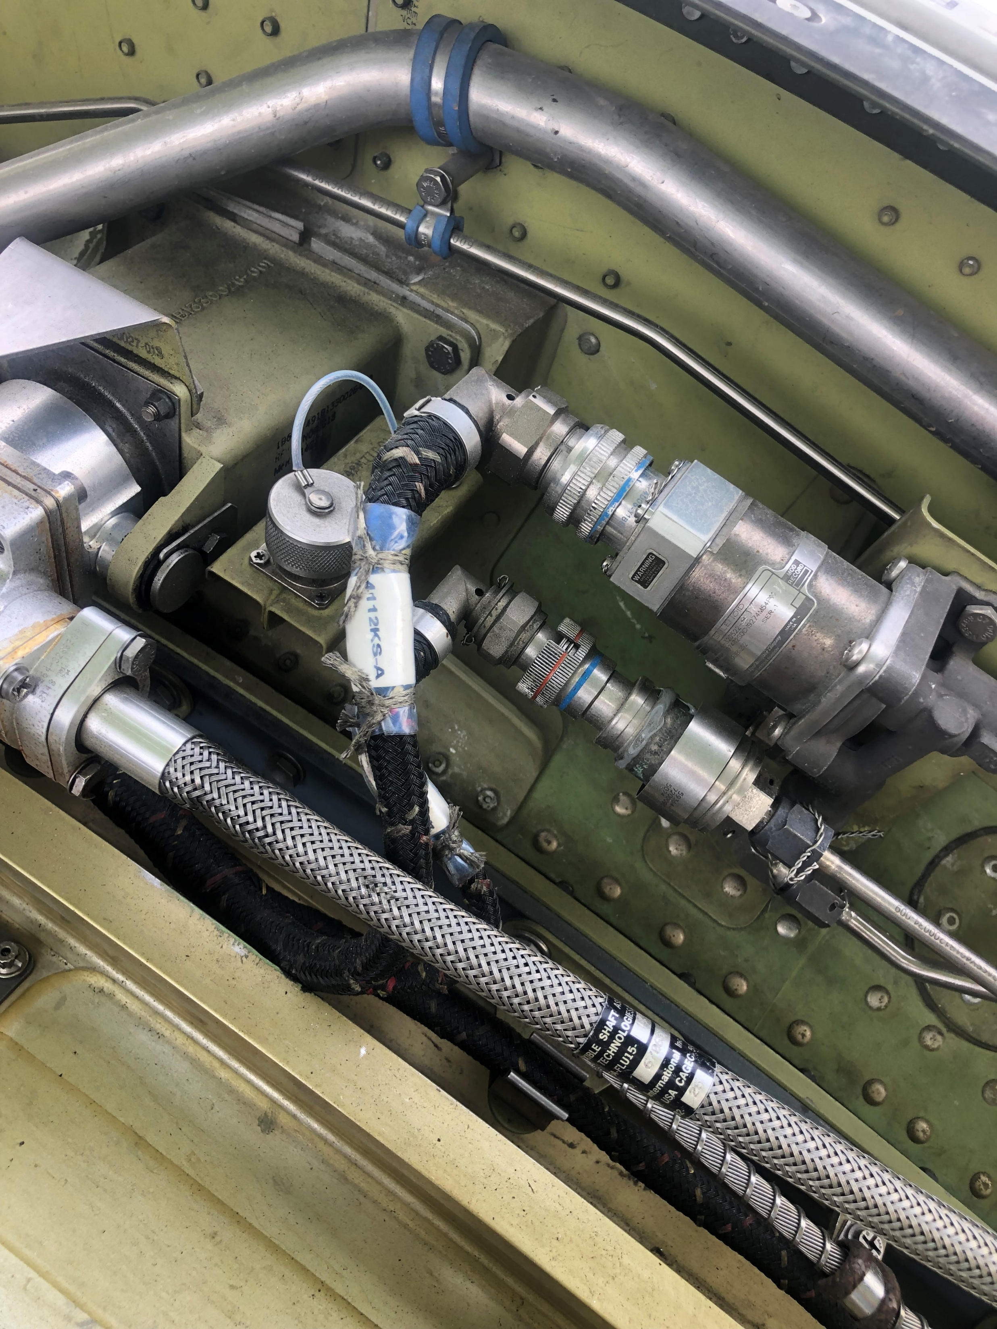
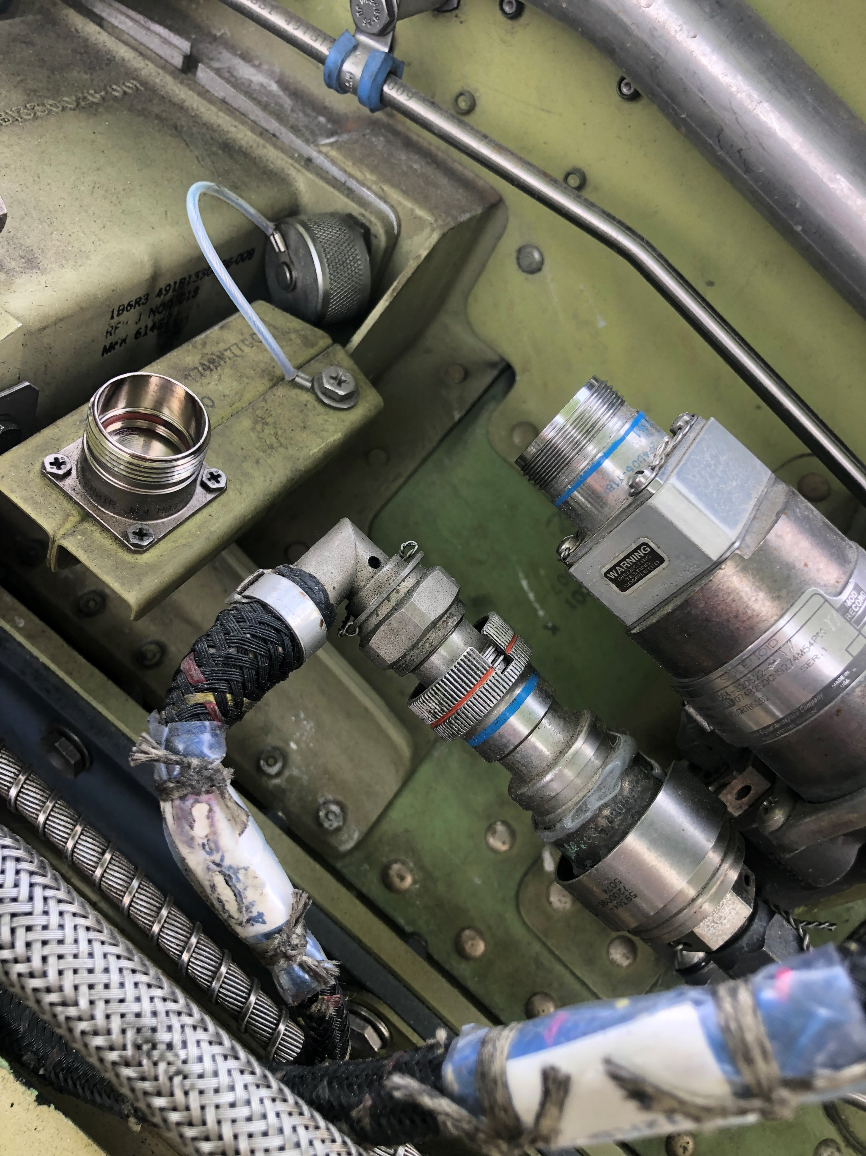
PROCEDURE FOR DEACTIVATION OF REVERSER ENGINE CF-6
AMM 78-31-00-040-801-A
*FIND THE DIRECTIONAL PILOT VALVE (DPV) AND PRESSURE SWITH MOUNTED ON THE TORQUE BOX AT THE 10 O´CLOCK POSITION.
DISCONNECT THE ELECTRICAL CONNECTOR FROM THE DPV SOLENOID. DO NOT DISCONNECT THE ELECTRICAL CONNECTOR FROM THE DPV PRESSURE SWITCH.

Slide 10
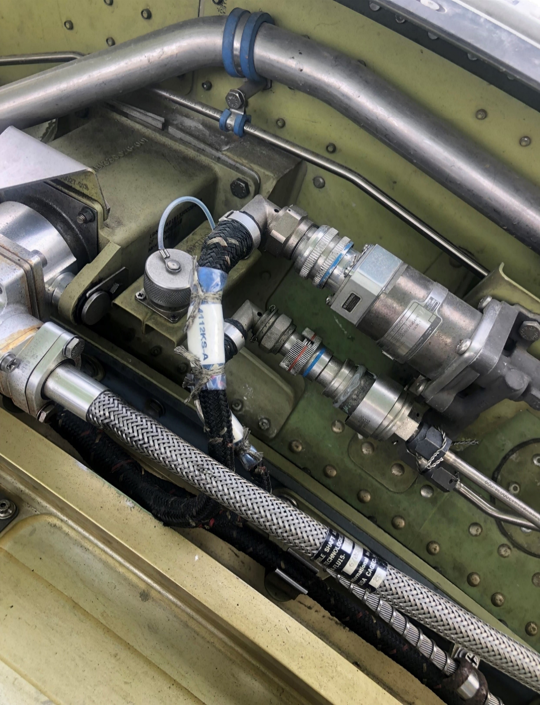
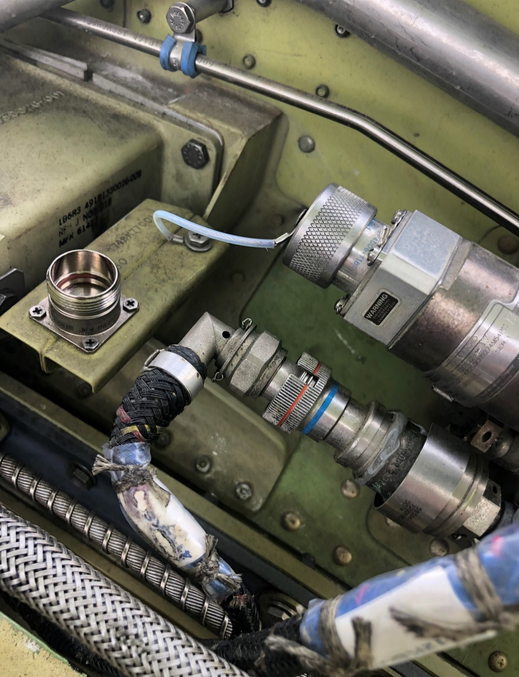
PROCEDURE FOR DEACTIVATION OF REVERSER ENGINE CF-6
AMM 78-31-00-040-801-A
*REMOVE THE DUST CAP FROM THE STORAGE BRAKET ON THE FIXED STRUCTURE NEXT THE DPV, AND INSTALL IT ON THE DPV SOLENOID.

Slide 11
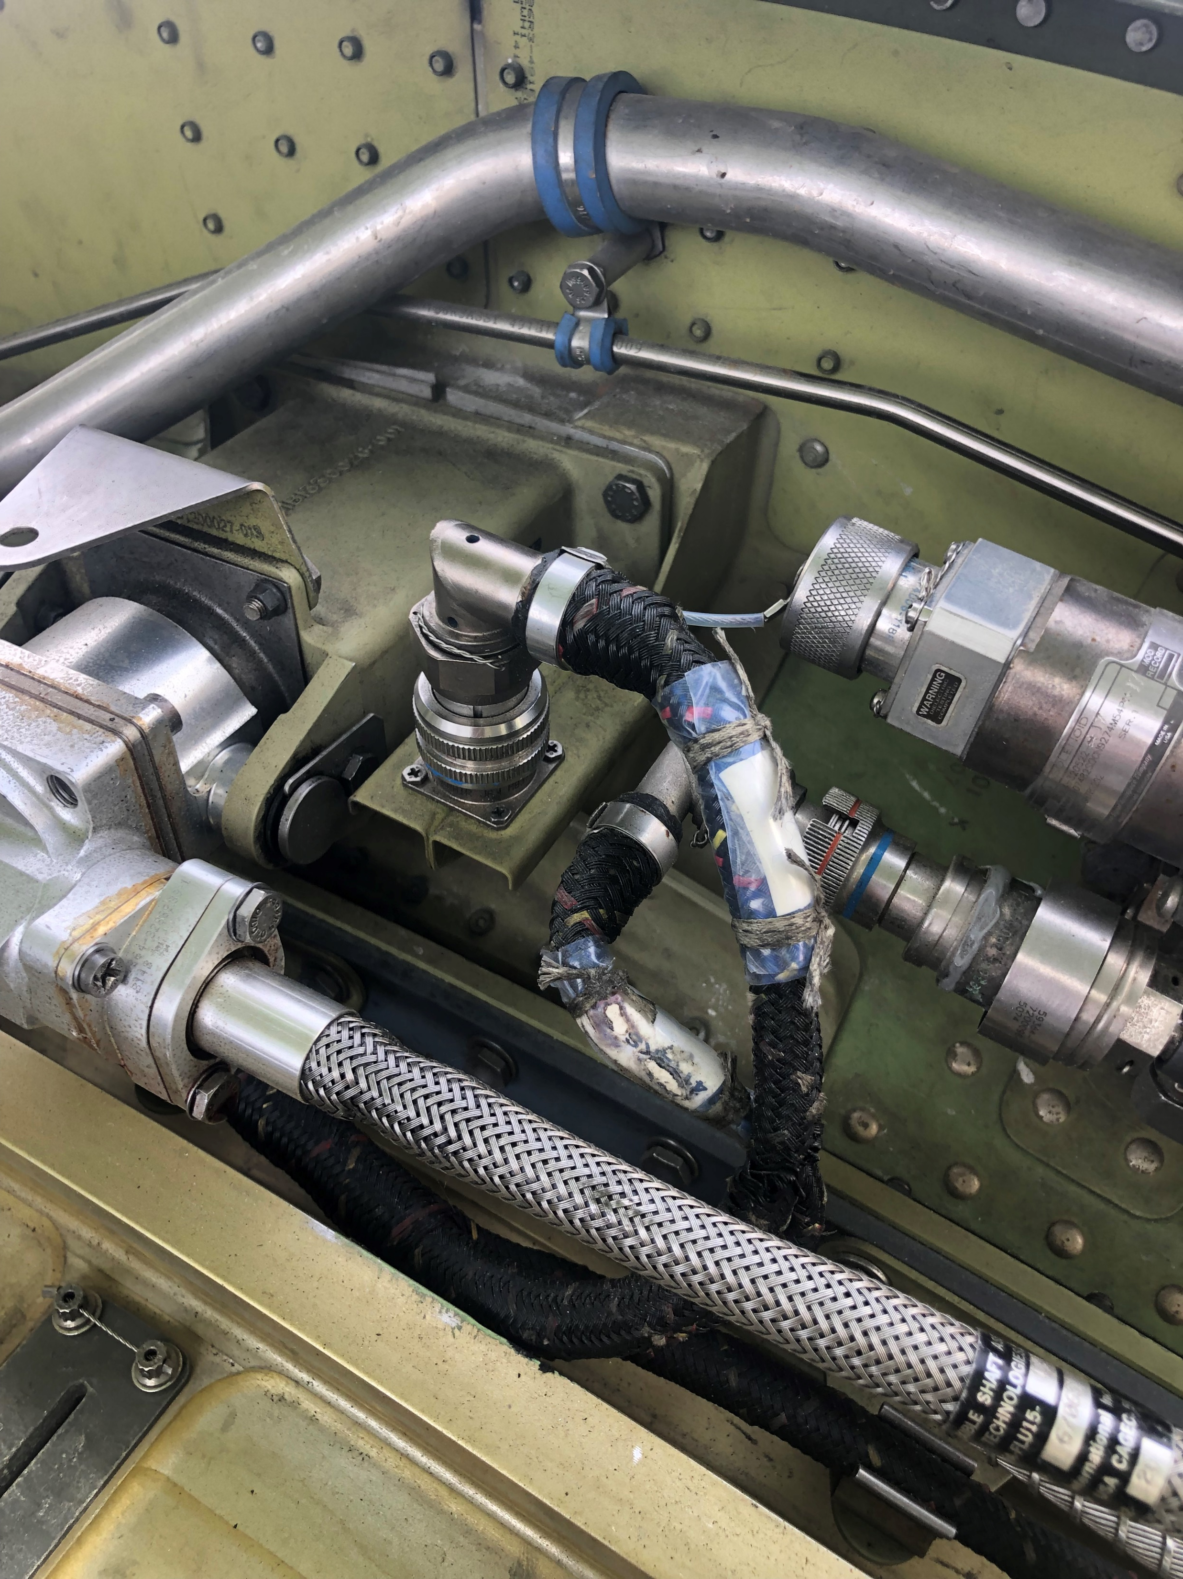
PROCEDURE FOR DEACTIVATION OF REVERSER ENGINE CF-6
AMM 78-31-00-040-801-A
*ATTACH THE ELECTRICAL CONNECTOR TO THE DUMMY CONNECTOR ON THE STORAGE BRACKET.

Slide 12
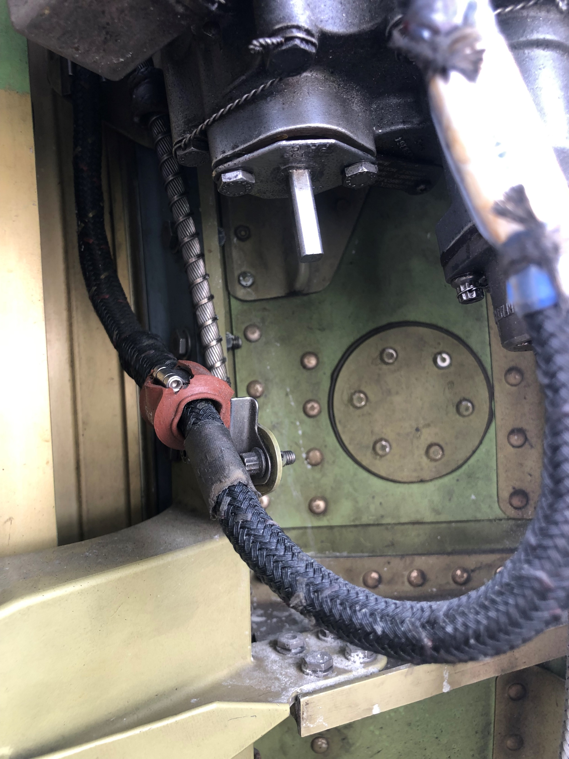
PROCEDURE FOR DEACTIVATION OF REVERSER ENGINE CF-6
AMM 78-31-00-040-801-A
*REMOVE THE TWO BOLTS THAT ATTACH THE STORED INVERTED CDU LOCKOUT COVER ON THE CDU AUXILIARY DRIVE PAD AND REMOVE THE LOCKOUT COVER.
*IN REVERSE LH
AND
*IN REVERSE RH

Slide 13
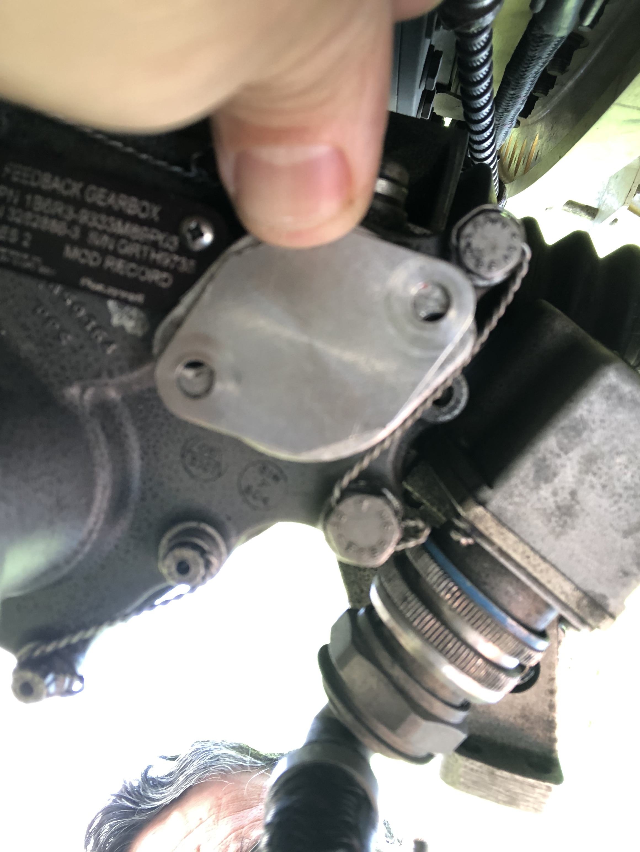

PROCEDURE FOR DEACTIVATION OF REVERSER ENGINE CF-6
AMM 78-31-00-040-801-A
*INSTALL THE UNINSTALLED LOCKOUT COVER INVERTED ON THE CDU AUXILIARY DRIVE WITH THE TWO BOLTS. THE RED INDICATION ON THE LOCKOUT COVER WILL BE VISIBLE.
*IN REVERSE LH
AND
*IN REVERSE RH
IF THE COVER PLATES HOLES ARE NOT ALIGNED WITH THE BOLTS SEATS.
GO TO “MANUAL CLOSURE OF THE REVERSES IN THIS PRESENTATION”.

Slide 14
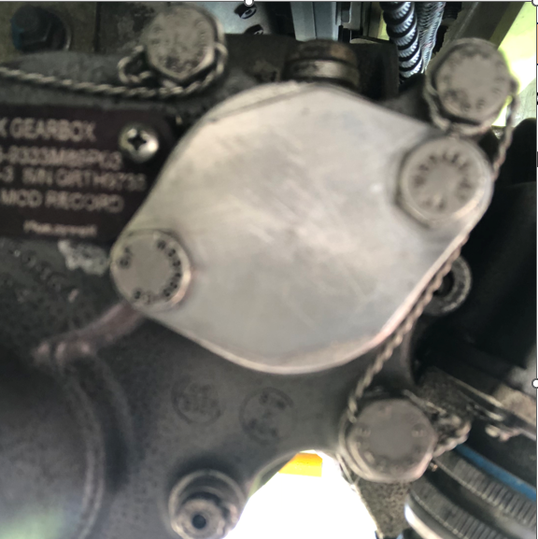
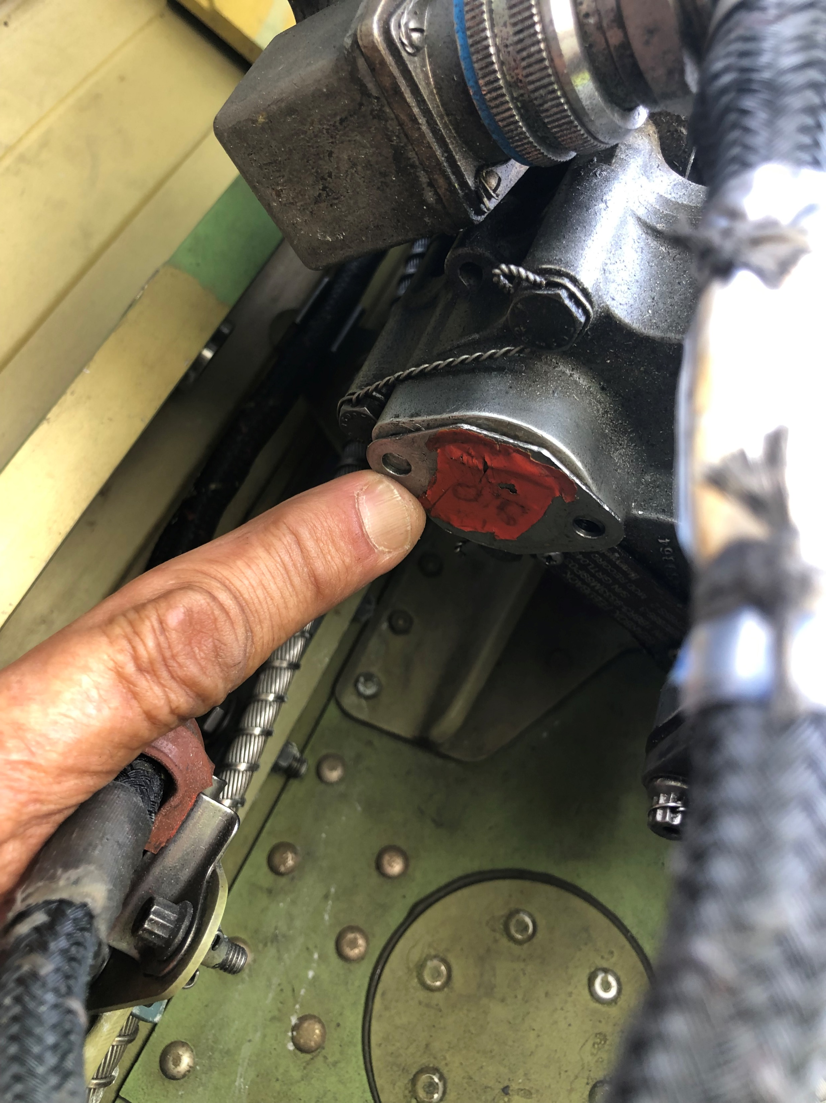

PROCEDURE FOR DEACTIVATION OF REVERSER ENGINE CF-6
AMM 78-31-00-040-801-A
*INSTALL THE SQUARE DRIVE OF THE CDU LOCKOUT COVER INTO THE AUXILIARY DRIVE AND ATTACH IT WITH THE BOLTS YOU REMOVED.
*MAKE SURE YOU CAN SEE THE RED-COLORED FACE OF THE LOCKOUT COVER. TORQUE THE BOLTS BERWEEN 33 AND 37 lbf.in
*IN REVERSE LH
AND
*IN REVERSE RH

Slide 15
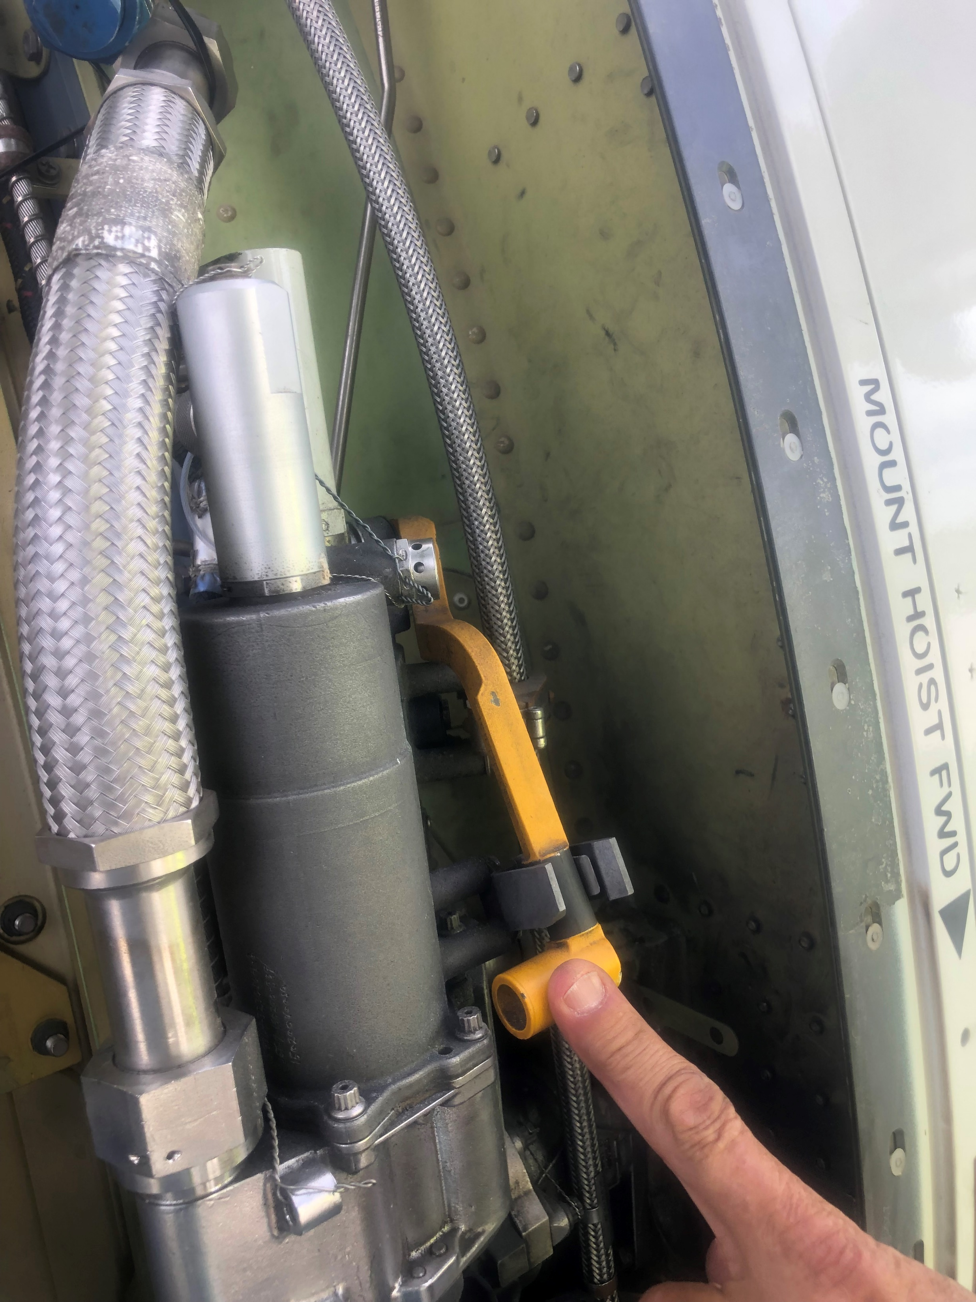
PROCEDURE FOR DEACTIVATION OF REVERSER ENGINE CF-6
AMM 78-31-00-040-801-A
*ONCE THE PLATE IS INSTALL WITH THE LOCKING SQUARE IN ITS CORRECT POSITION AND FIXED WITH ITS BOLTS. WE MUST PLACE THE CLUTCH LEVER IN IST INITIAL POSITION IF NECESSARY.
*IN REVERSE LH
AND
*IN REVERSE RH

Slide 16
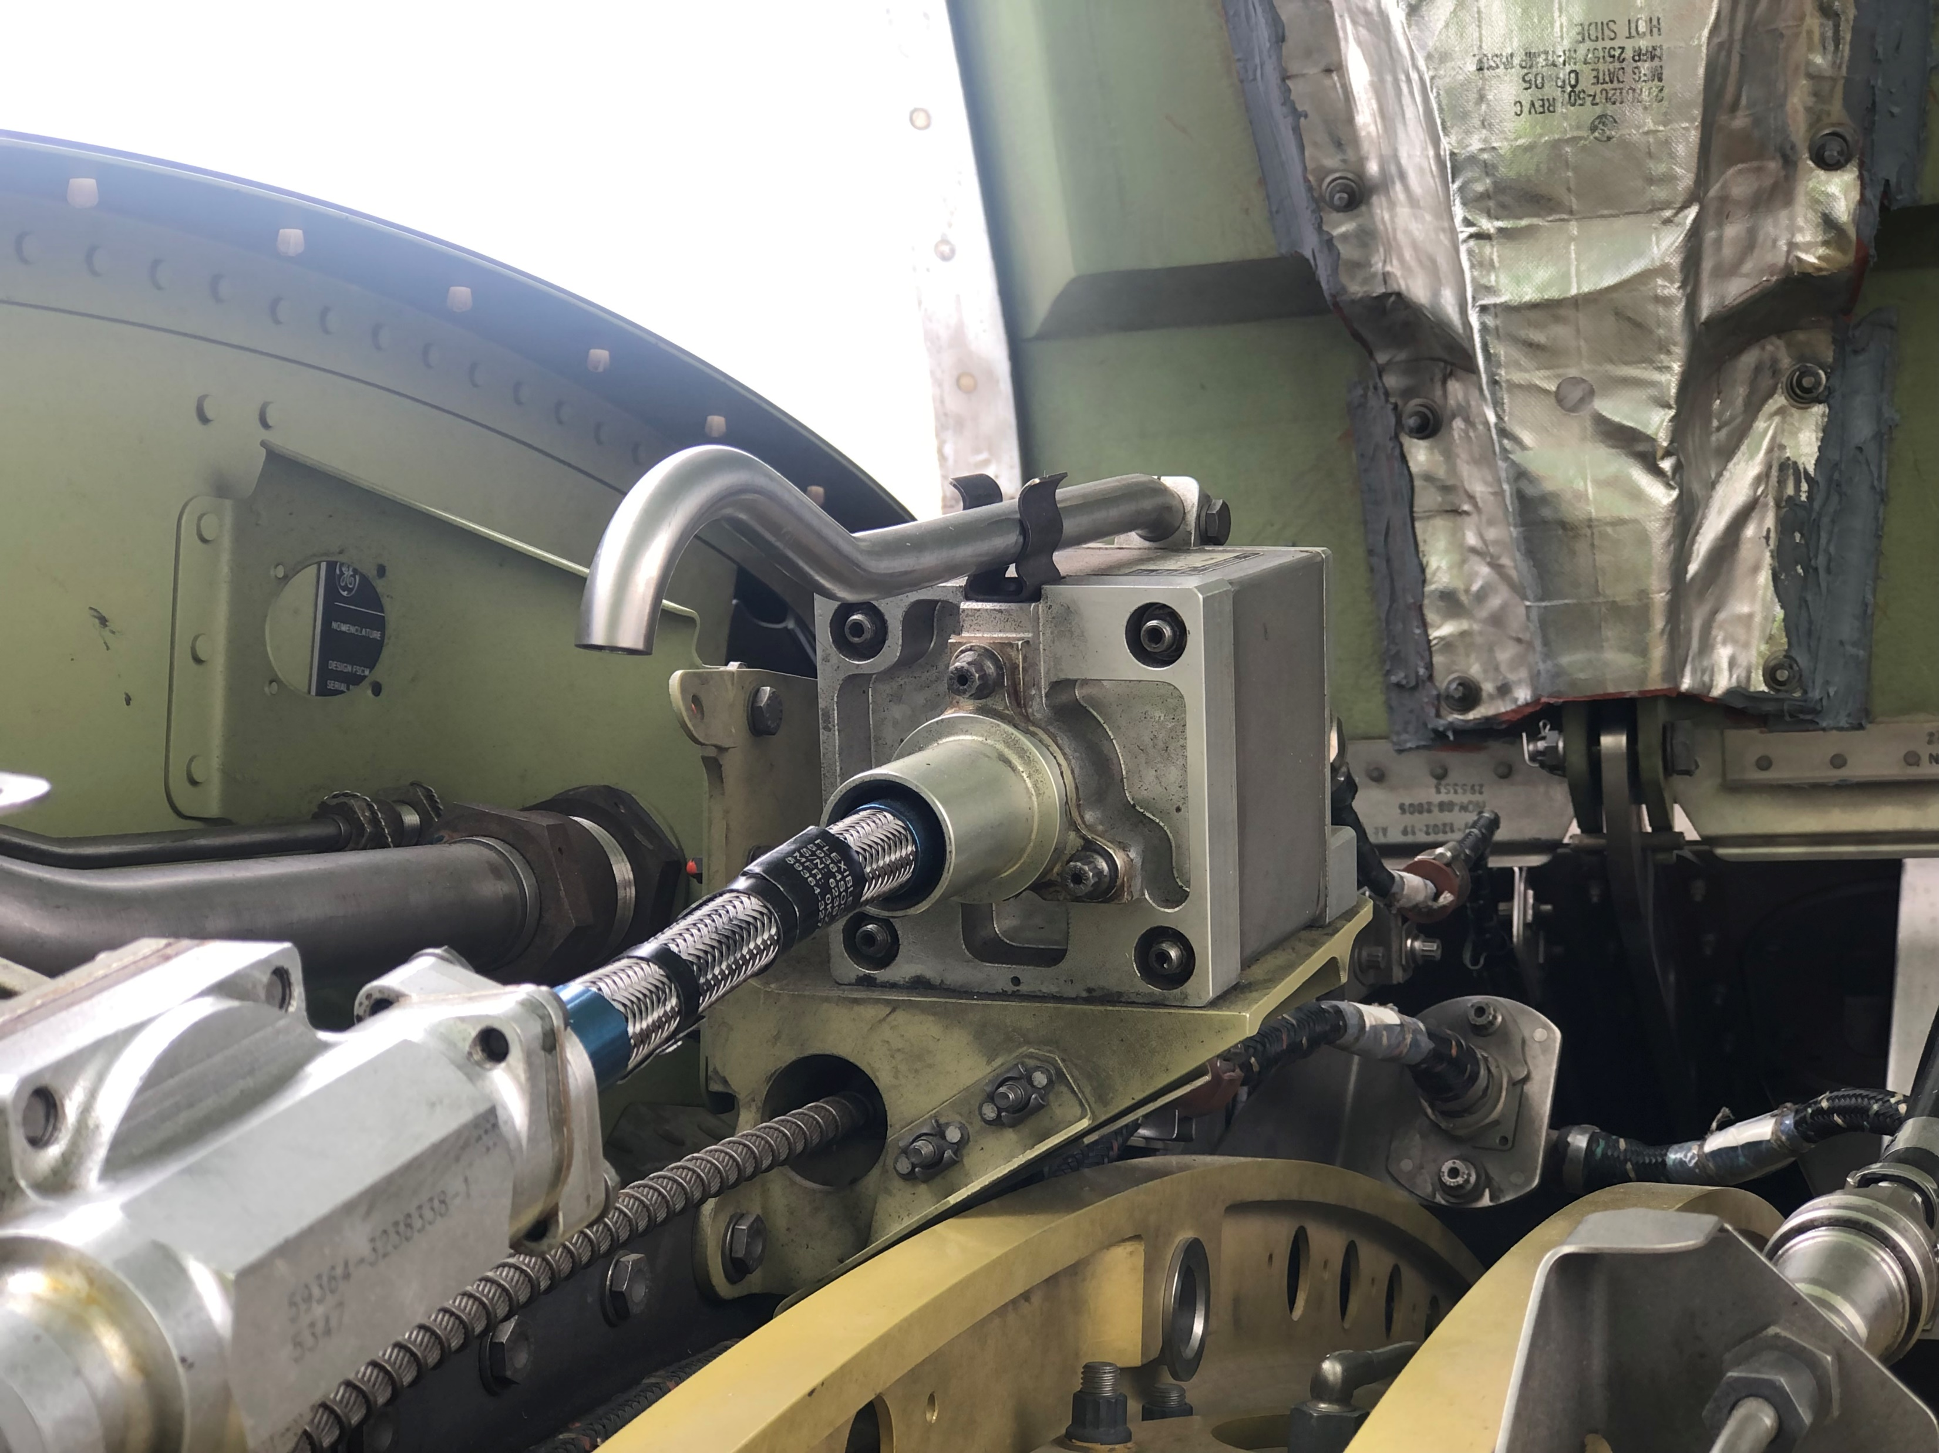
PROCEDURE FOR DEACTIVATION OF REVERSER ENGINE CF-6
AMM 78-31-00-040-801-A
*ONCE THE PLATE IS INSTALL WITH THE LOCKING SQUARE IN ITS CORRECT POSITION AND FIXED WITH ITS BOLTS. WE MUST PLACE THE CLUTCH LEVER IN IST INITIAL POSITION IF NECESSARY.
*IN REVERSE LH
AND
*IN REVERSE RH

Slide 17
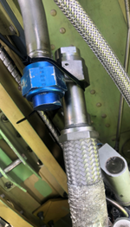
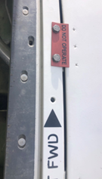
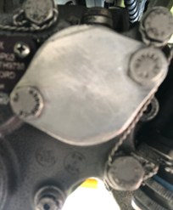
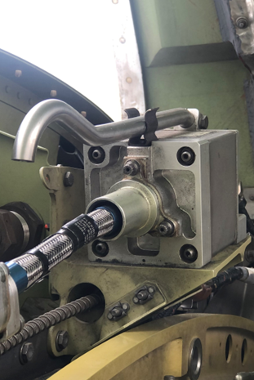

PROCEDURE FOR DEACTIVATION OF REVERSER ENGINE CF-6
AMM 78-31-00-040-801-A
CHECK LIST AFTER DEACTIVATION OF THE REVERSE.
*IN REVERSE LH
AND
*IN REVERSE RH
*PLATES LOCATED
IN SIX POSITIONS
*IN REVERSE LH
AND
*IN REVERSE RH
*IN REVERSE LH
*IN REVERSE LH
AND
*IN REVERSE RH
*IN REVERSE LH
AND
*IN REVERSE RH

Slide 18
PROCEDURE FOR DEACTIVATION OF REVERSER ENGINE CF-6
AMM 78-31-00-040-801-A
*REMOVE THE SAFETY CLIP CIRCUIT BREAKER AND THE TAG AND CLOSE THIS CIRCUIT BREAKERS
721VU | TRPV ENG 1 | 38KS1 | S09
721VU | TRDV ENG 1 | 37KS1 | S08
722VU | FADEC B ENG 1 | 13KS1 | D44
742VU | FADEC A ENG 1 | 12KS1 | Q73
FOR FIN 4030EM2(DEMOUNTABLE POWER PLANT, ENG2)
722VU | FADEC B ENG 2 | 13KS2 | K49
722VU | TRDV ENG 2 | 37KS2 | T36
722VU | TRPV ENG 2 | 38KS2 | U36
742VU | FADEC A ENG 2 | 12KS2 | Q74
*PUSH THE ENG 1(2) FADEC GROUND POWER PUSHBUTTON SWITCH. THE ON LEGEND OF THIS PUSHBUTTON SWITCH COMO ON.
*ON THE EWD MAKE SURE THAT THE “ENG1(2) REV INHIBITED” MESSAGE IS SHOWN.
*PUT A WARNING NOTICE IN POSITION TO TELL THE FLIGHT CREW TO IGNORE THE “REV PRESSURIZED” WARNING IF THE WARNING COME INTO VIEW ON THE GROUND/IN THE AIR AFTER THE THRUST REVERSER IS DEATIVATED.

Slide 19
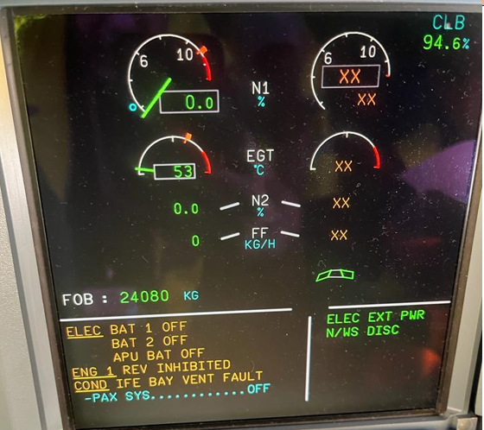
PROCEDURE FOR DEACTIVATION OF REVERSER ENGINE CF-6
AMM 78-31-00-040-801-A
*PUSH THE ENG 1(2) FADEC GROUND POWER PUSHBUTTON SWITCH. THE ON LEGEND OF THIS PUSHBUTTON SWITCH COMO ON.
*ON THE EWD MAKE SURE THAT THE “ENG1(2) REV INHIBITED” MESSAGE IS SHOWN.
*PUT A WARNING NOTICE IN POSITION TO TELL THE FLIGHT CREW TO IGNORE THE “REV PRESSURIZED” WARNING IF THE WARNING COME INTO VIEW ON THE GROUND/IN THE AIR AFTER THE THRUST REVERSER IS DEATIVATED.

Slide 20
PROCEDURE FOR DEACTIVATION OF REVERSER ENGINE CF-6
AMM 78-31-00-040-801-A
END OF REVERSE DEACTIVATION
THE NEX BELOW PRESENTATION OF THE MANUAL CLOSING OF THE REVERSES

Slide 21
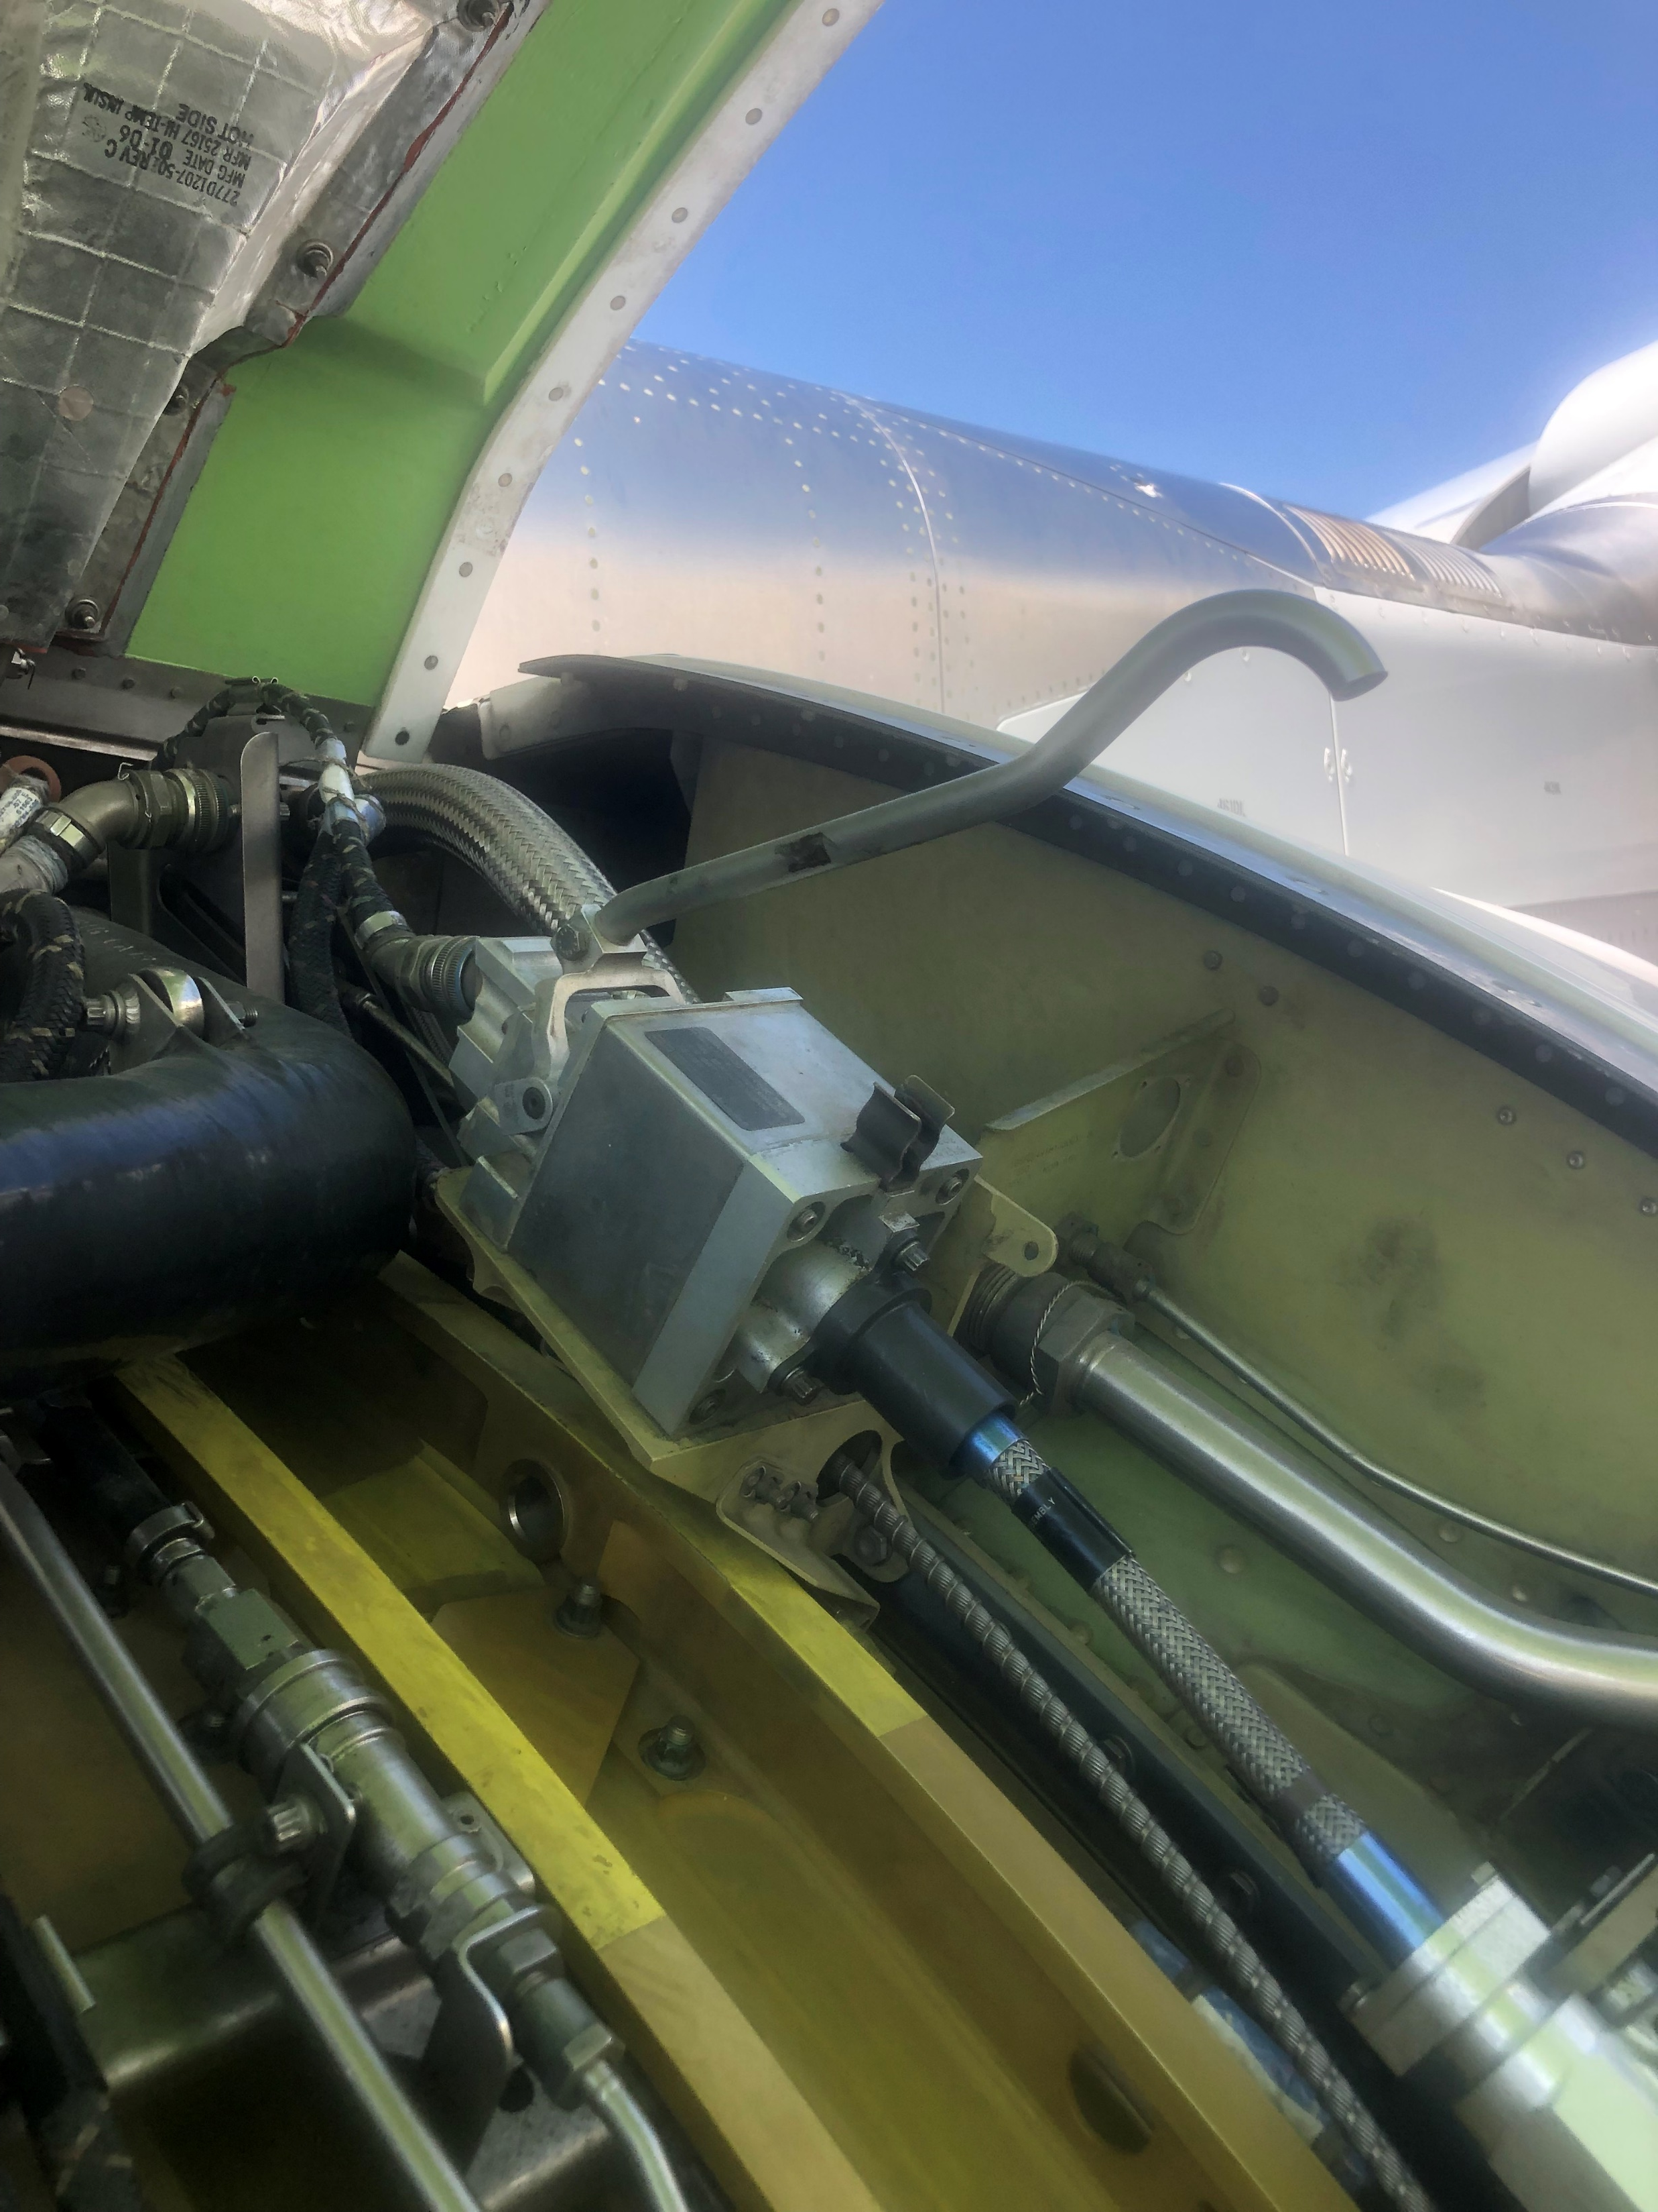
ENGINE CF-6.THRUST MANUAL STOWING ONLY IF IT IS NECESSARY
AMM 78-32-65-860-802-A
MOVE THE LEVER OF THE THRUST REVERSER BRAKE IN UP PISITION TO ALLOW MANUAL MOVEMENT OF THE REVERSE

Slide 22

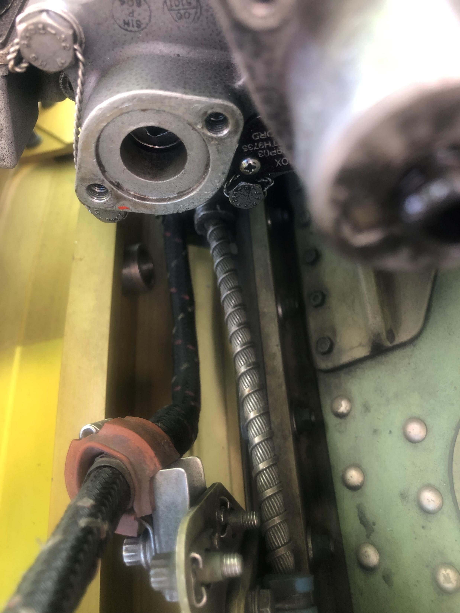
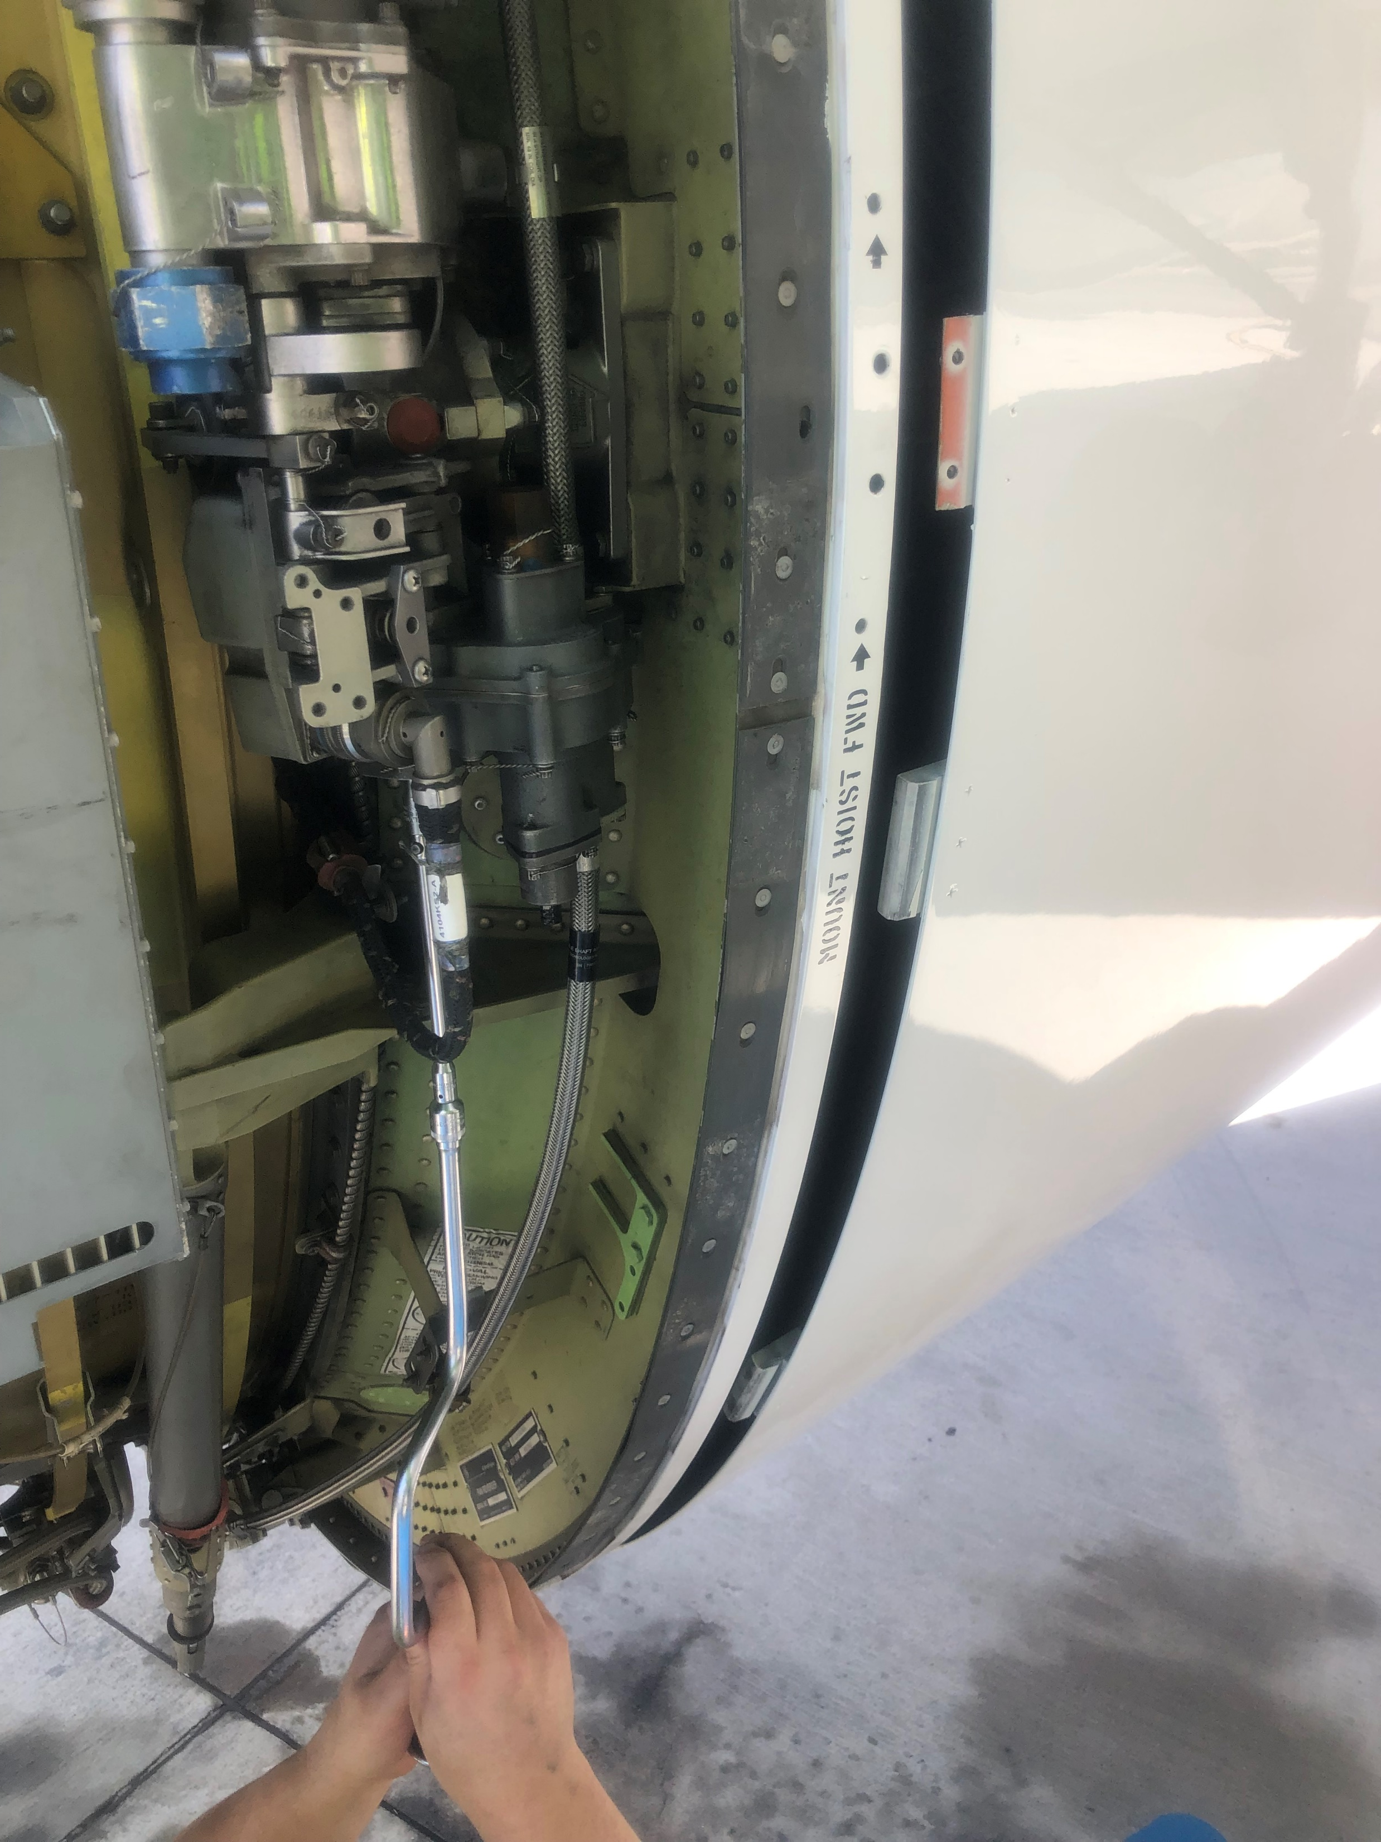
ENGINE CF-6.THRUST MANUAL STOWING
AMM 78-32-65-860-802-A
USE A SPEED HANDLE DRIVE ¼ SQUARE INTO THE AUXILARY DRIVE PAD, TO DREVE THE CDU. TURN THE SPEED HANDLE UNTIL THE TRASLATING COWL IS IN THE STOW POSITION
REMOVE THE LOCKOUT PLATE OF THE CDU.

Slide 23
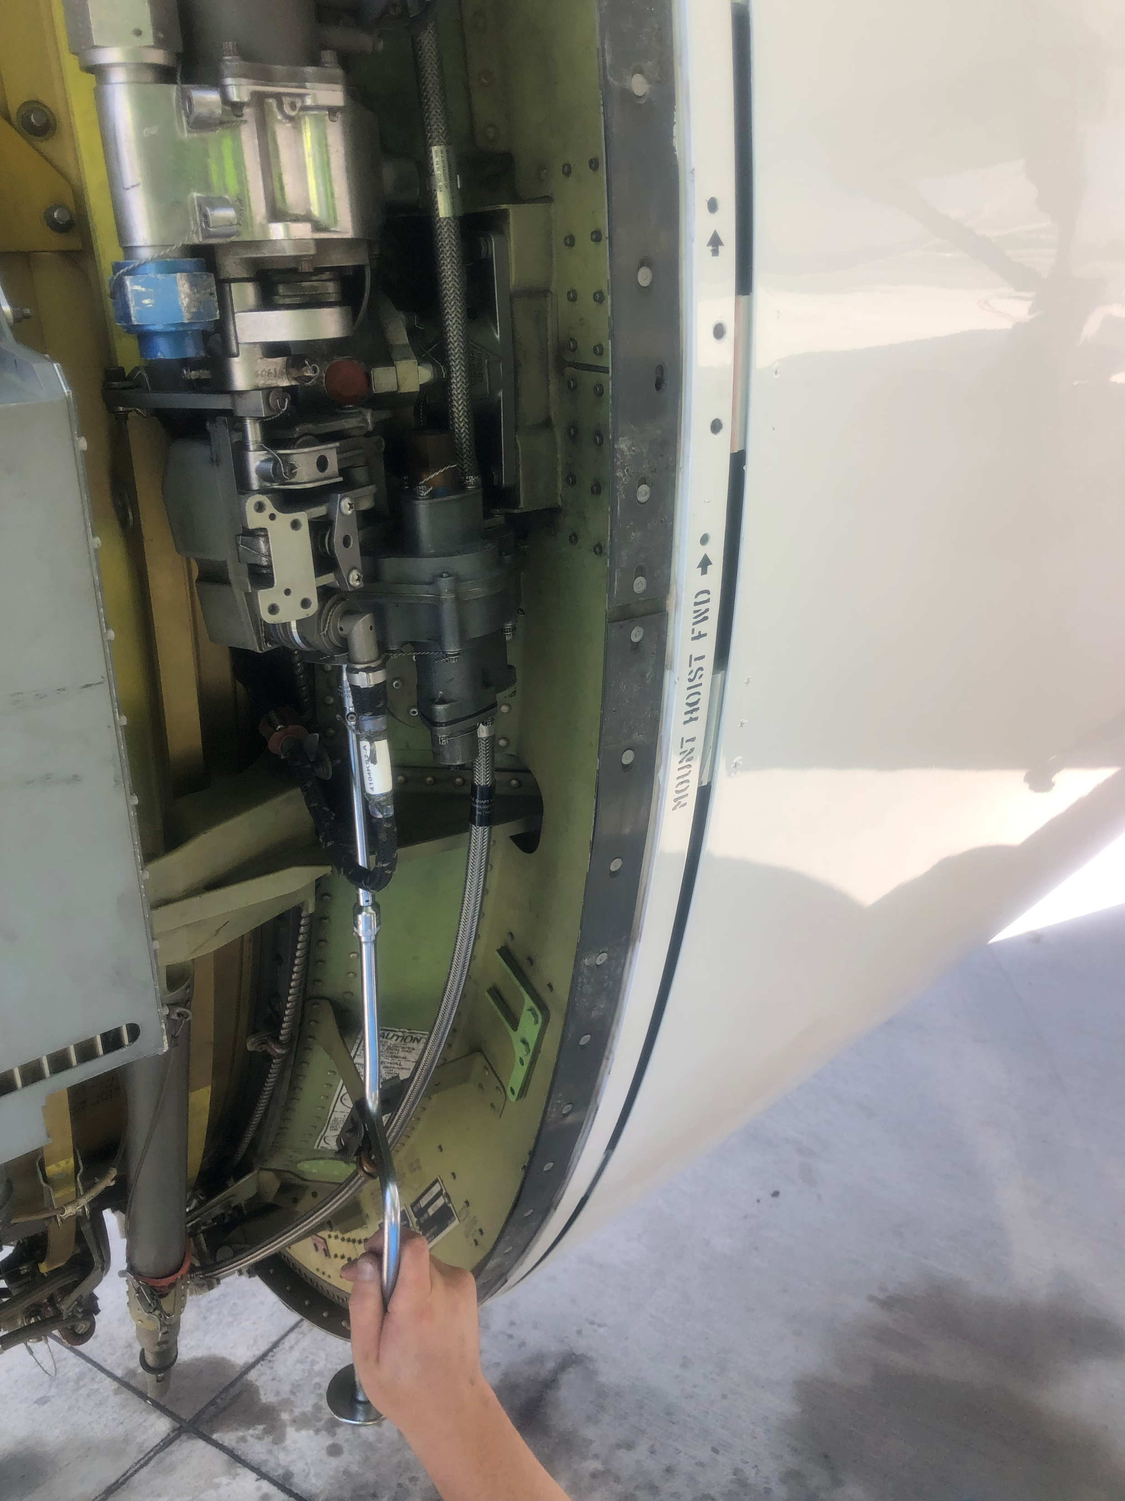
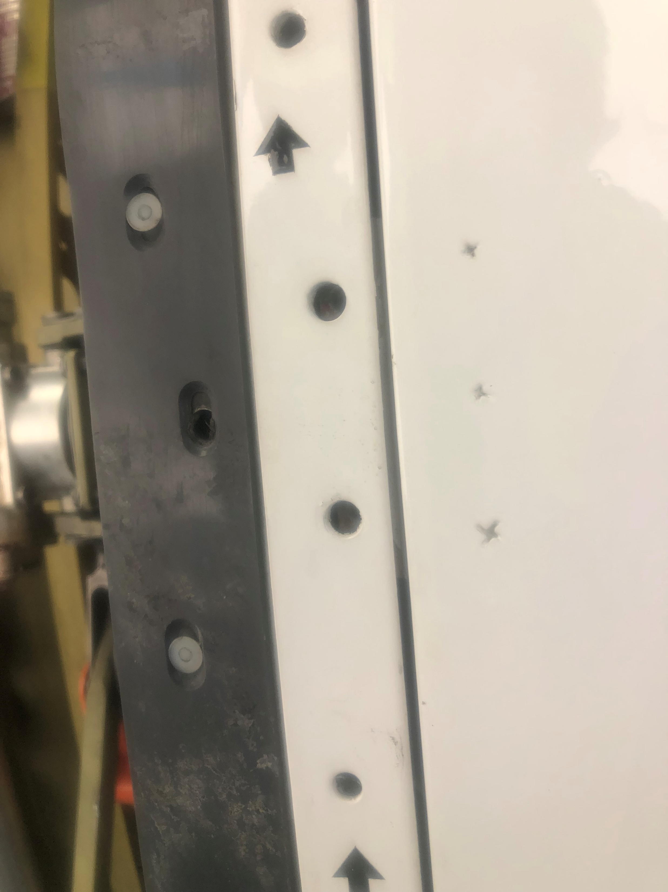
ENGINE CF-6.THRUST MANUAL STOWING
AMM 78-32-65-860-802-A
USE A SPEED HANDLE DRIVE ¼ SQUARE INTO THE AUXILARY DRIVE PAD, TO DREVE THE CDU. TURN THE SPEED HANDLE UNTIL THE TRASLATING COWL IS IN THE STOW POSITION
NOTE. THERE WILL BE AN AUDIBLE SOUND WHEN THE TRASLATING COWL REACHES THE STOW POSITION
YOU CAN SEE IN THE LOCKING HOLES ALIGNED WITH THE FIXING NUTS THEM

Slide 24
ENGINE CF-6.THRUST MANUAL STOWING
AMM 78-32-65-860-802-A
PLACE THE LOCK PLATE OVER THE MANUAL DRIVE PAD AND SECURE WITH THE BOLT THAT WAS REMOVED.
SEE NEXT PAGE

Slide 25
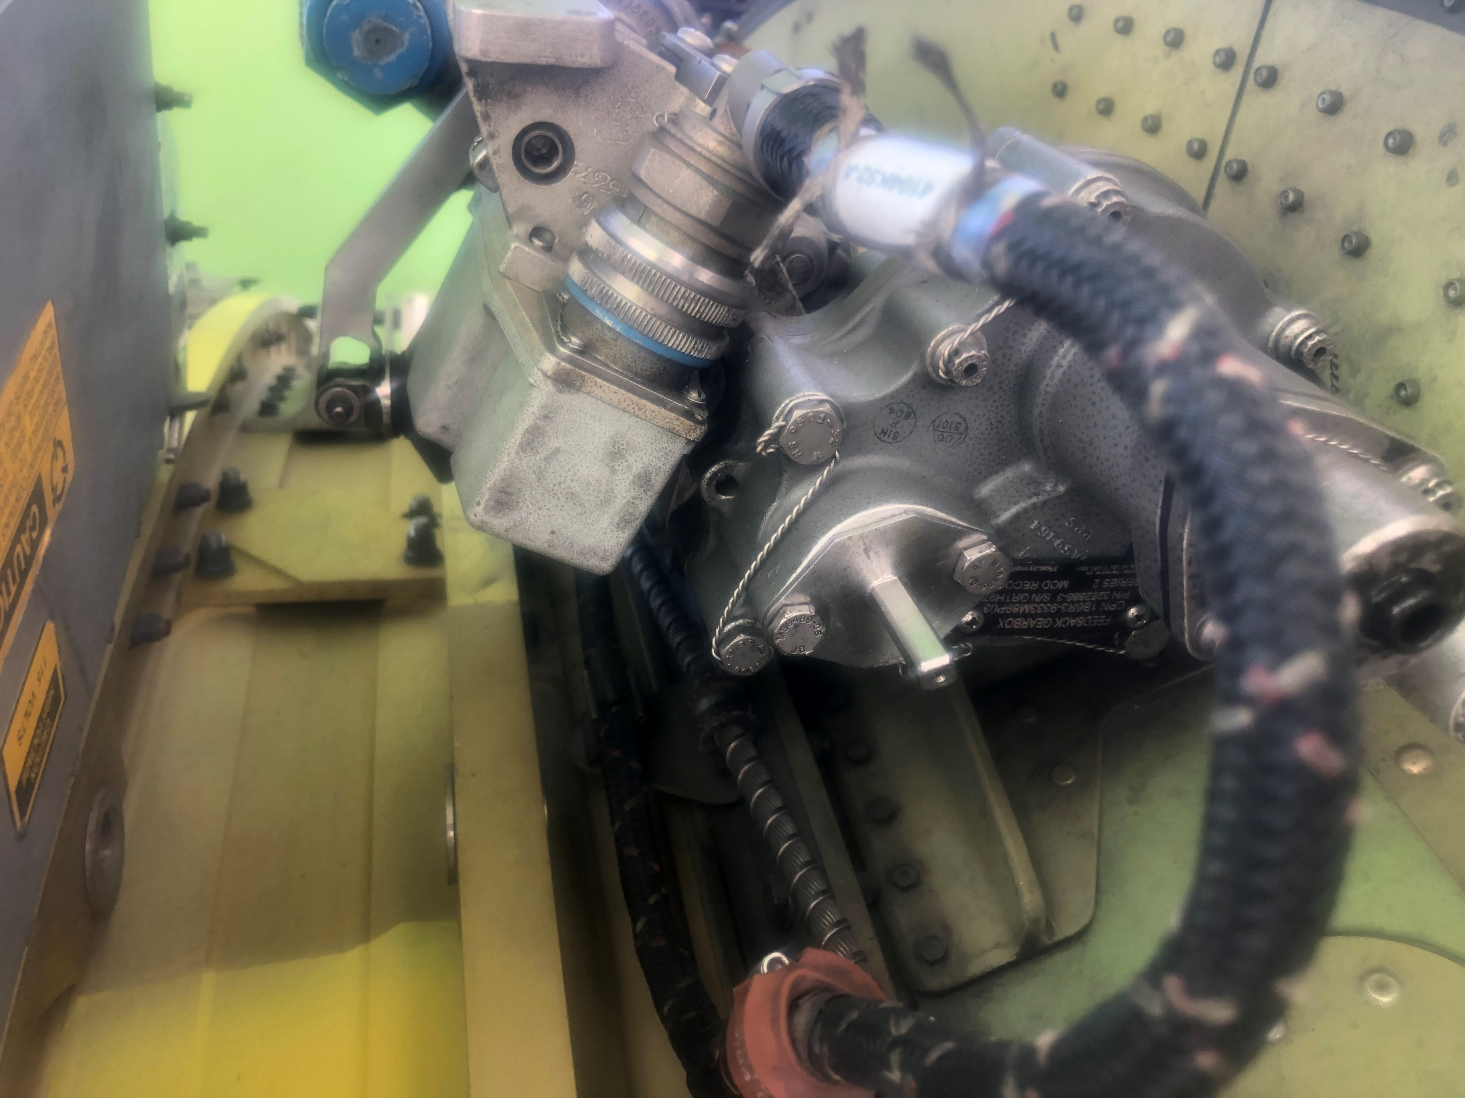


ENGINE CF-6.THRUST MANUAL STOWING
AMM 78-32-65-860-802-A
IF THE REVERSE IS GOING TO BE DISPACHED OPERATIONAL.
PLACE THE LOCK PLATE OVER THE MANUAL DRIVE PAD AND SECURE WITH THE BOLT THAT WAS REMOVED. TORQUE THE BOLTS TO BETWEEN 33 AND 37 lbf. in
IF THE REVERSE IS GOING TO BE BLOCKED, THE PLATE OVER MUST BE PLACED IN THE INVERSE POSITION. RED PAINT BUST BE VISIBLE.
TORQUE THE BOLTS TO BETWEEN 33 AND 37 lbf. in

Slide 26
ENGINE CF-6.THRUST MANUAL STOWING
ENGINE CF-6.THRUST MANUAL STOWING
AMM 78-31-00-040-801-A
END OF THE PRESENTATION

